Slide 1


Water Management for Sustainable Development
India Water Week-2015

Slide 2
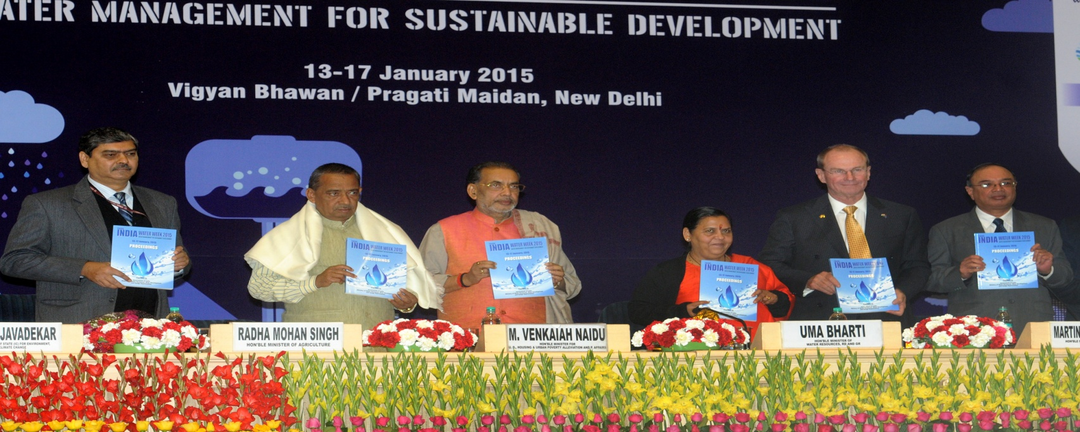

Slide 3
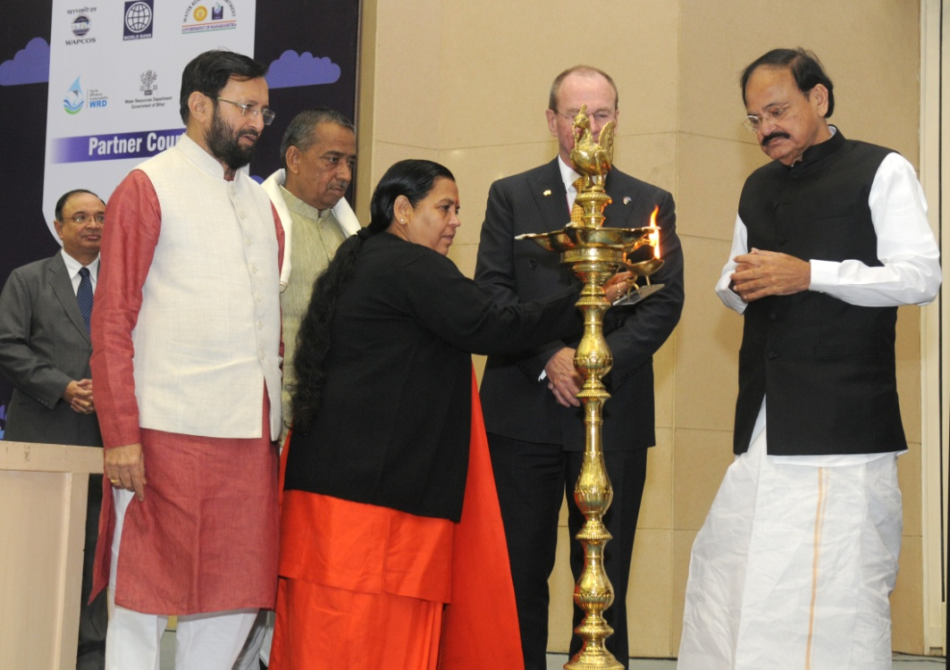

Slide 4
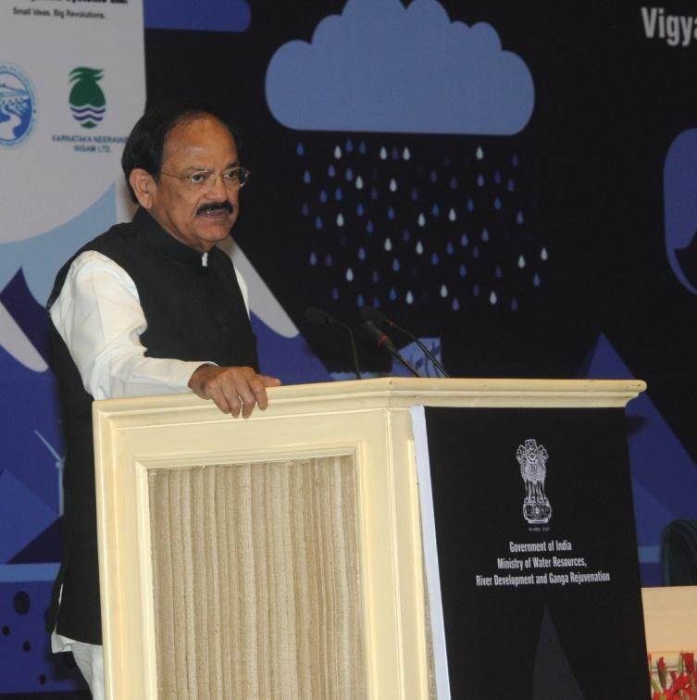

Slide 5
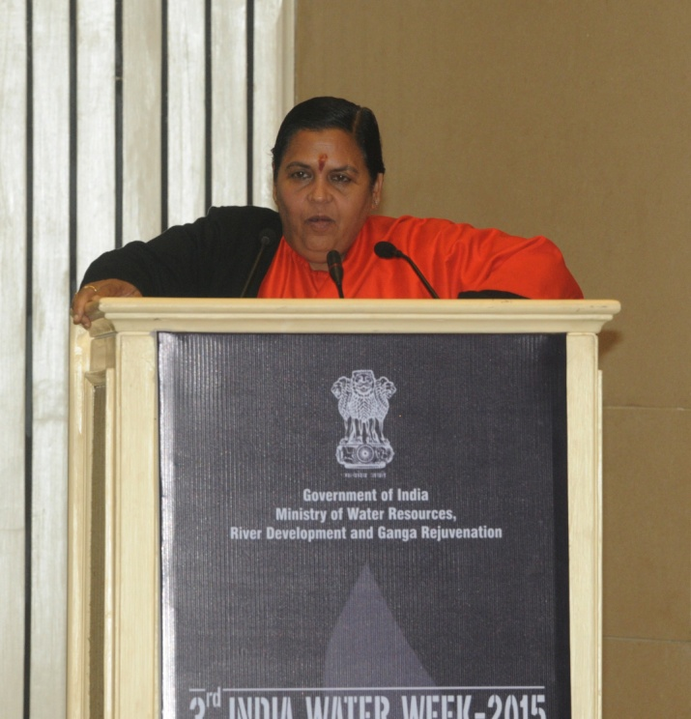

Slide 6
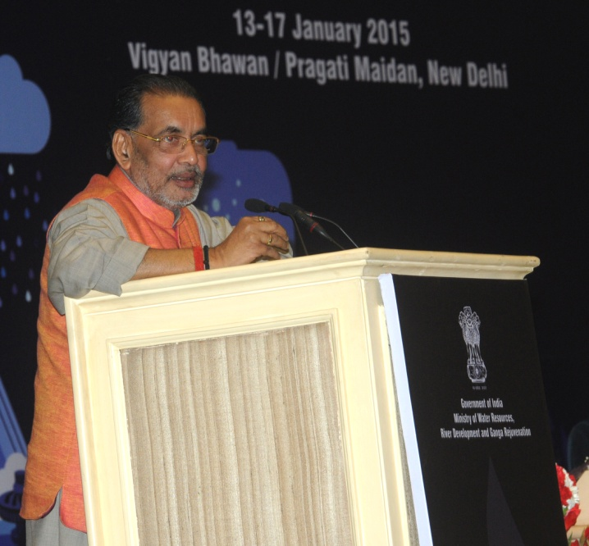

Slide 7
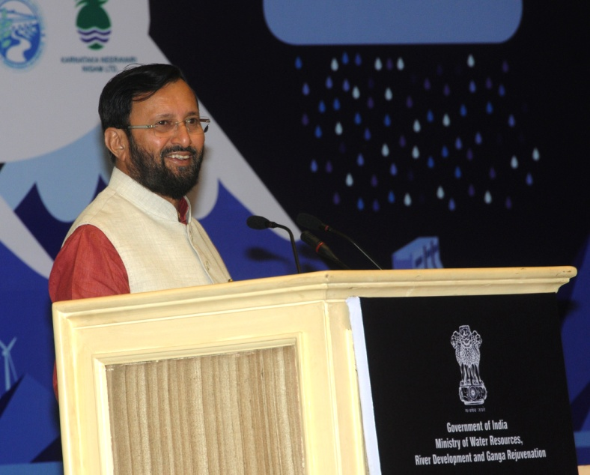

Slide 8
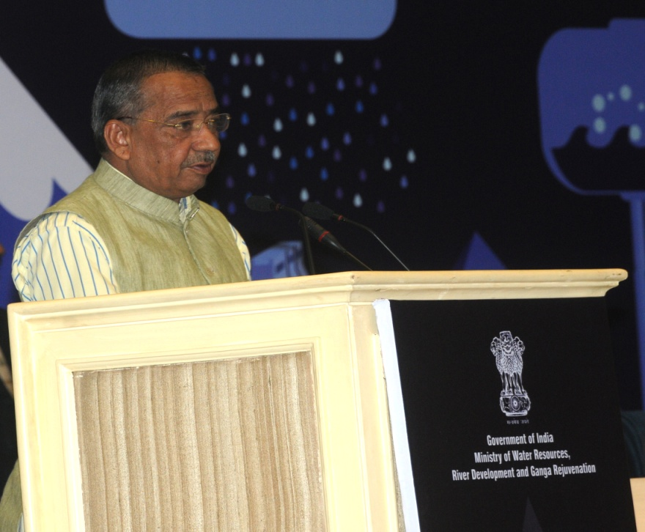

Slide 9
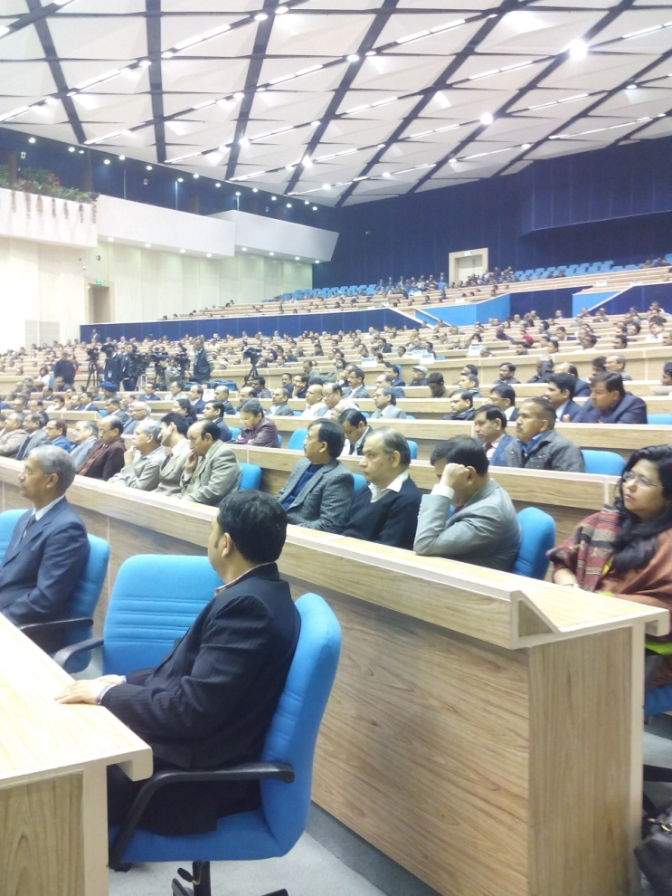
Inauguration at Vigyan Bhawan
India Water Week-2015

Slide 10
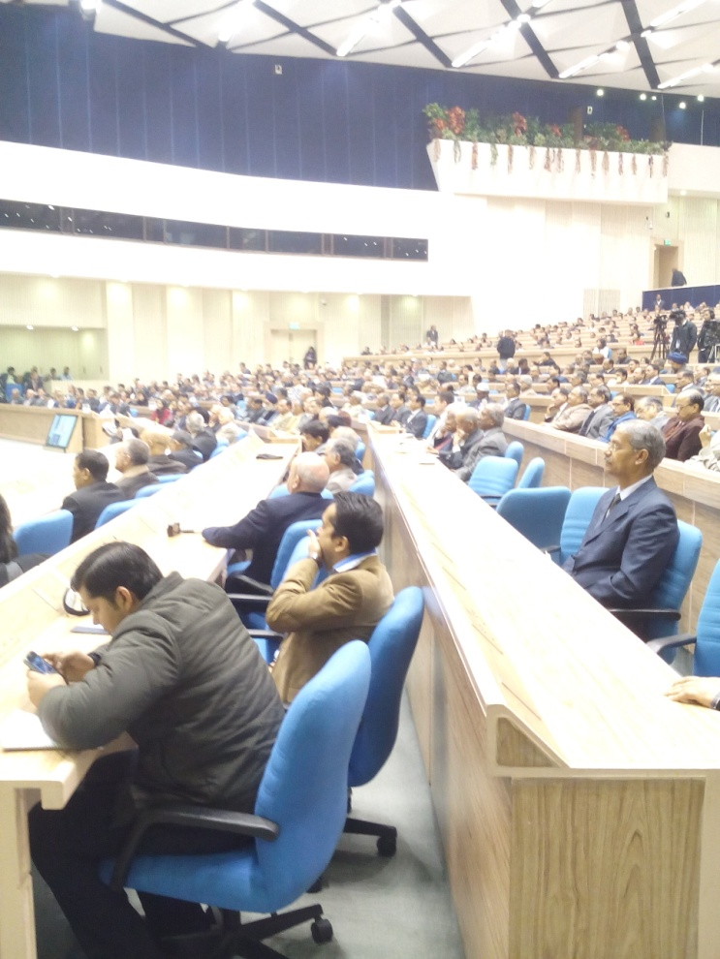
Inauguration at Vigyan Bhawan
India Water Week-2015

Slide 11
The Events Organized
Plenary Session
15 Seminars
13 Panel Discussions
9 Brainstorming Sessions
2 Training Programmes
3 Case Studies
Dedicated Special Events on “GWP South Asia and SAARC Regional Day from Risk to Resilience ” organized by the GWP
India Water Week-2015

Slide 12
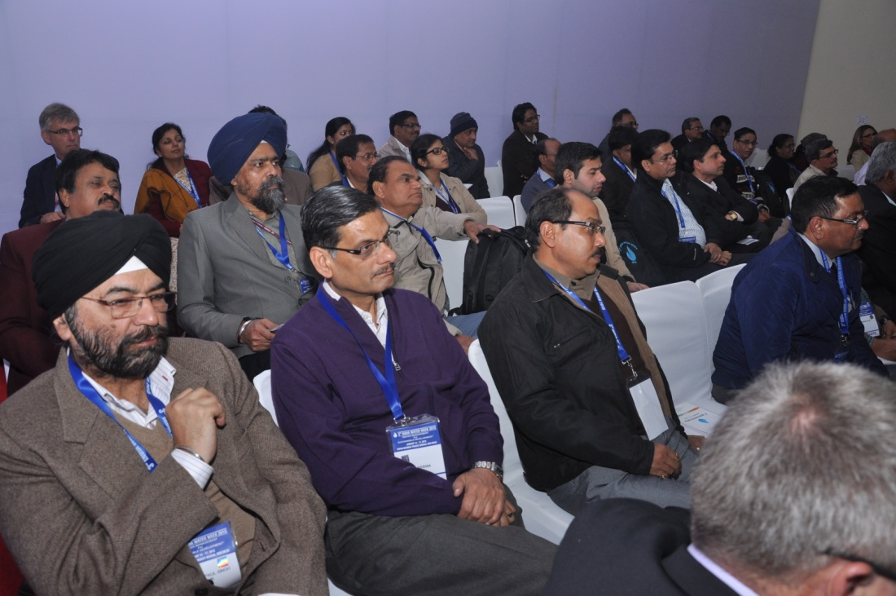
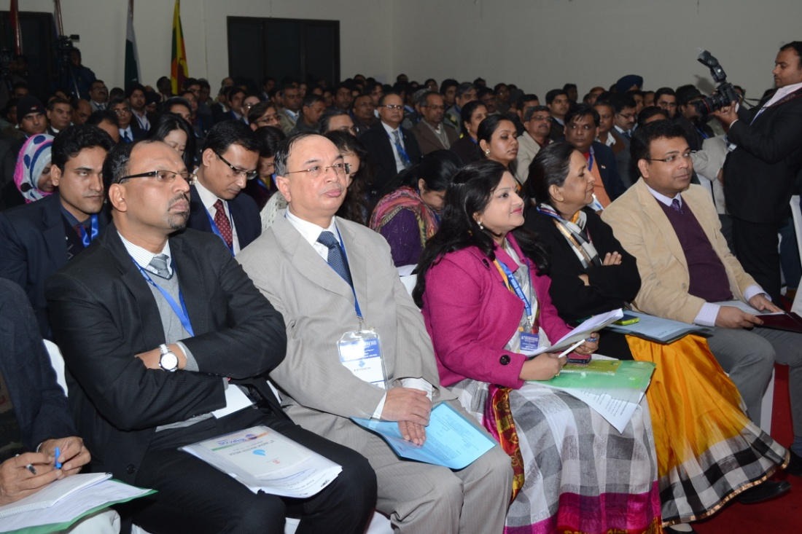
Widespread Gathering
India Water Week-2015

Slide 13
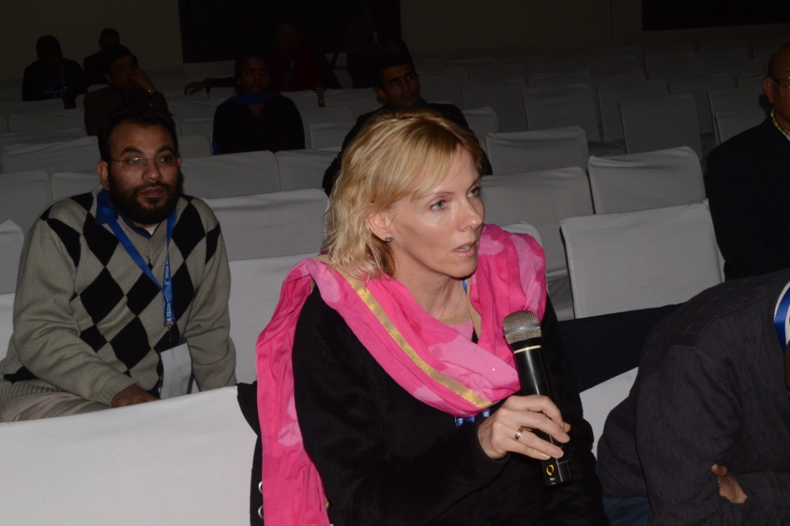
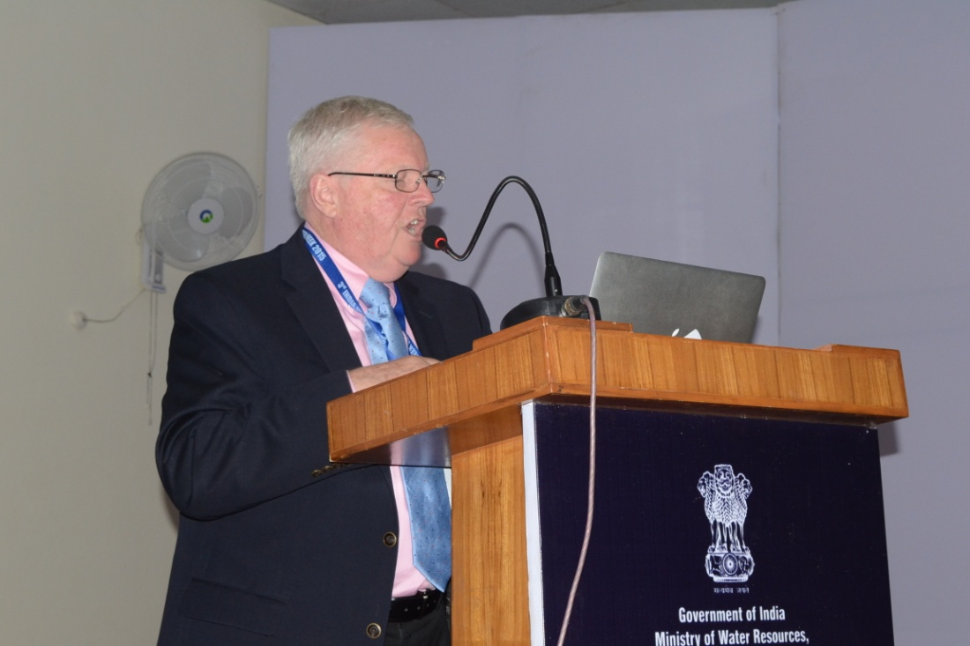
Experience from across the world
India Water Week-2015

Slide 14
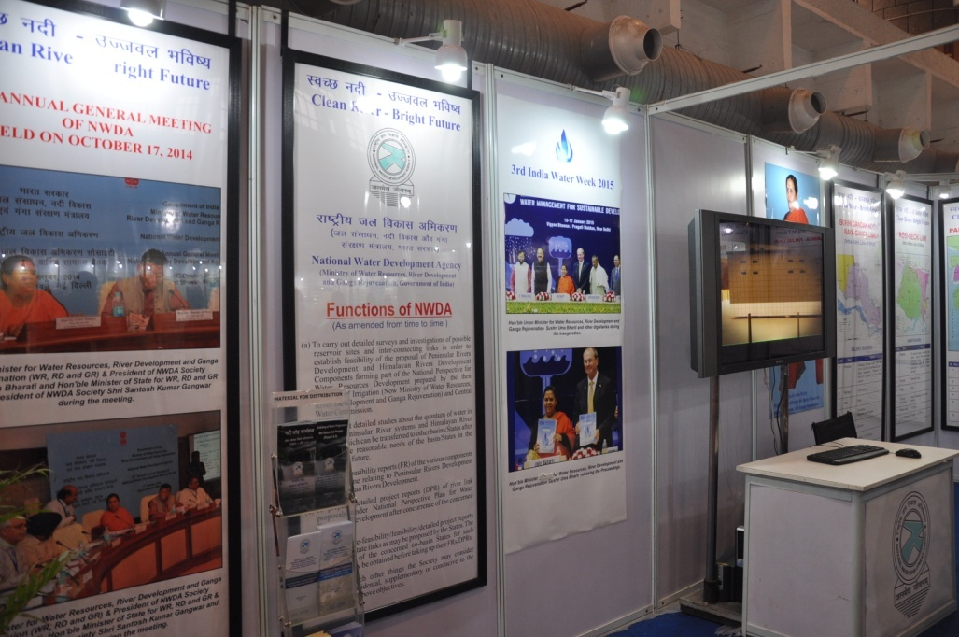
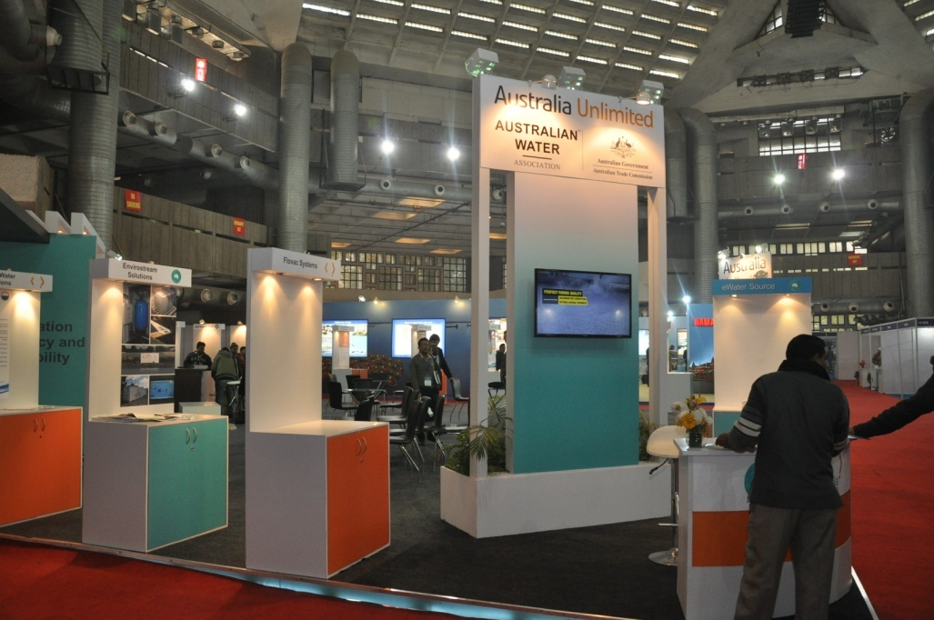
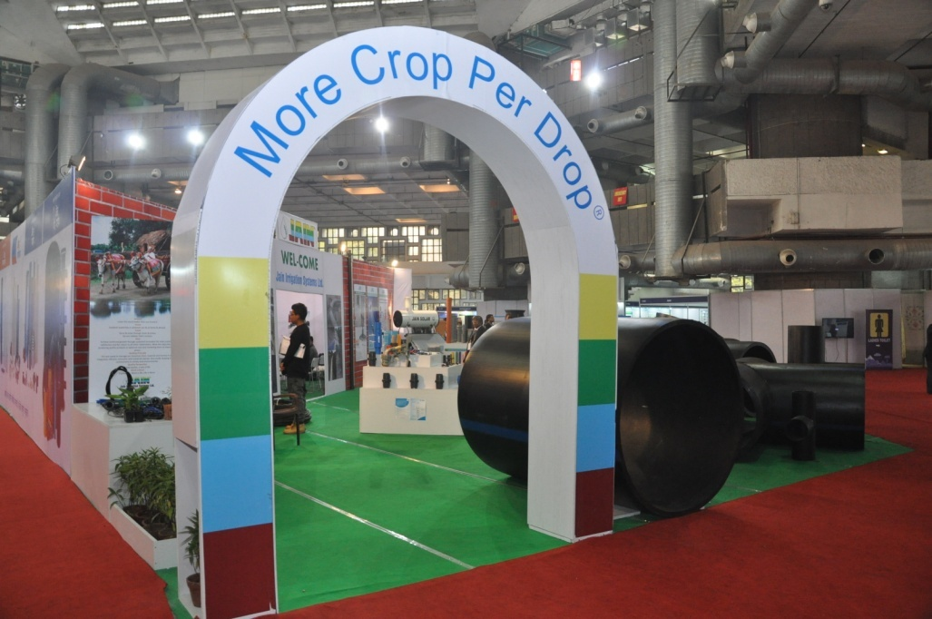
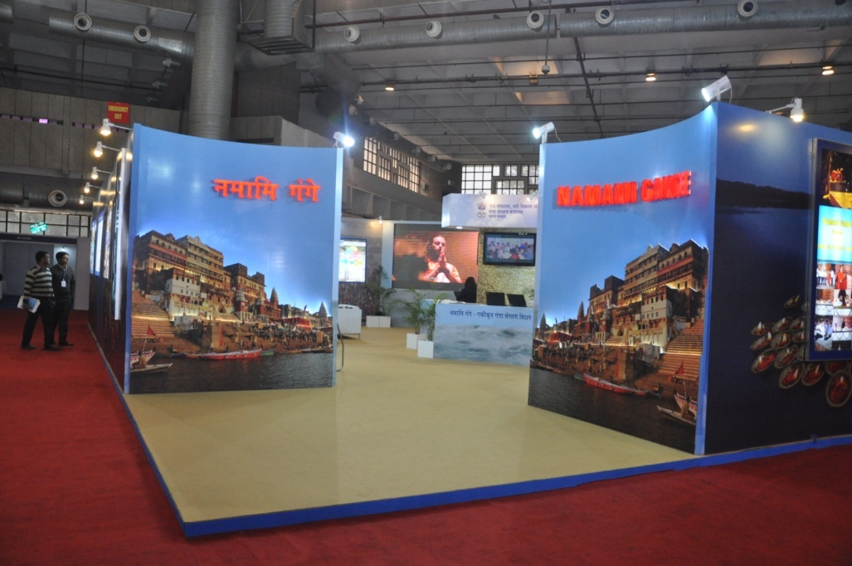
Exhibitions from various stakeholders
India Water Week-2015

Slide 15
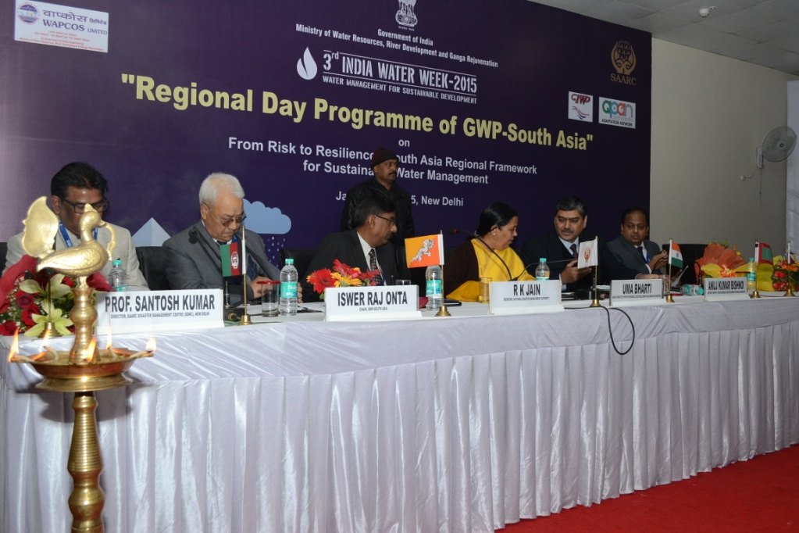
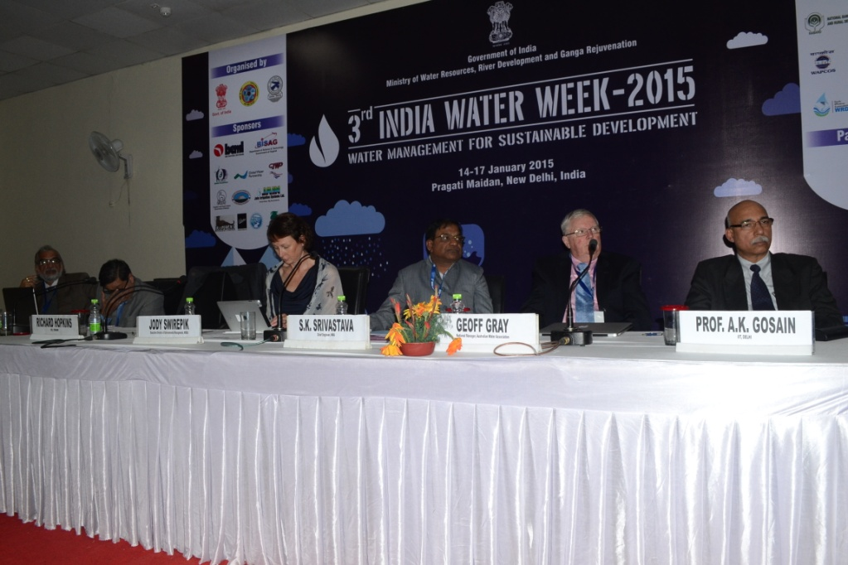
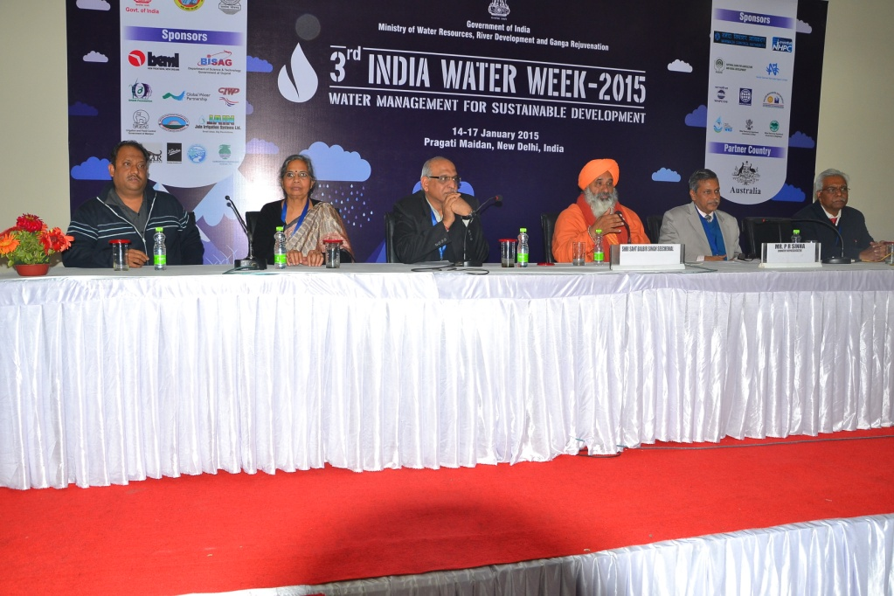
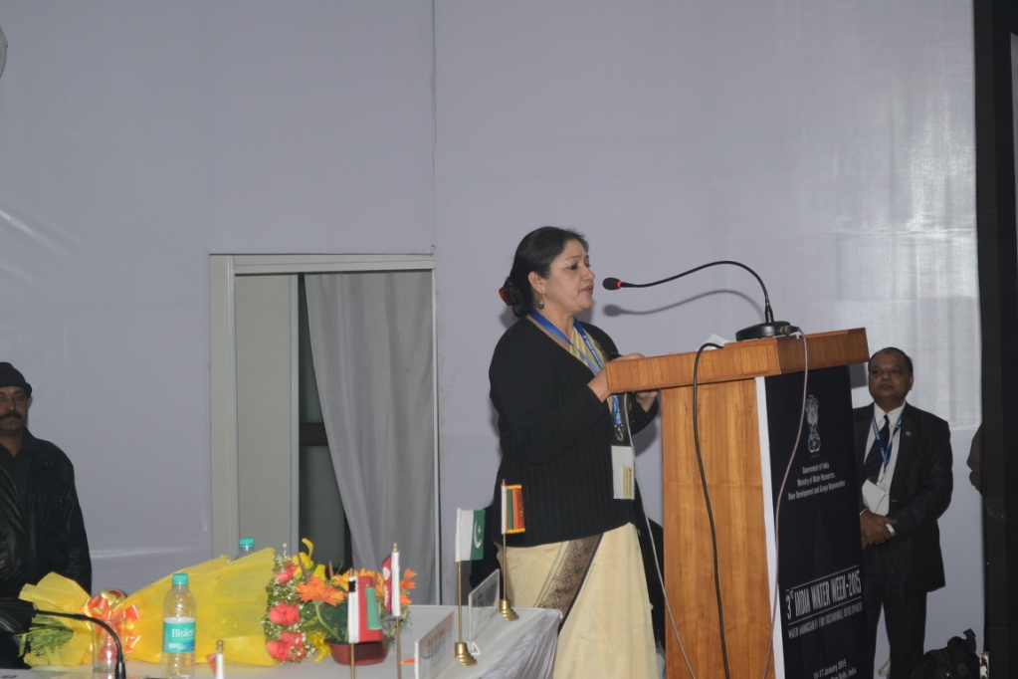
Intensive discussions
India Water Week-2015

Slide 16
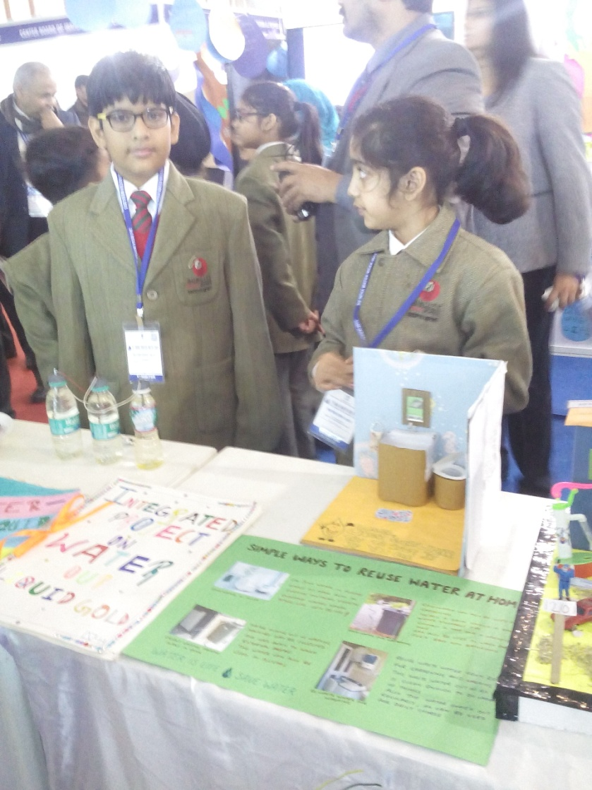
Enthusiastic
participation
from
younger
generation
India Water Week-2015

Slide 17
Highlights
Total of 1450 delegates ncluding 110 delegates from foreign countries.
Products and services were displayed by 82 companies and agencies
School children and academicians also joined exhibition showcasing their original efforts
India Water Week-2015

Slide 18
Important Recommendations
India Water Week-2015

Slide 19
Sub-Theme : 1
Water for Sustaining Life
Adoption of water ethics in policies and practices regarding planning and management of water resources including mitigation of drought is the need of the hour.
Environmental and ecological needs of the river should be assessed on scientific basis to make adequate provisions for the environmental sustainability of the river and adequate storage needs to be created to augment the flows during lean season to meet these requirements.
India Water Week-2015

Slide 20
Sub-Theme-2
Water Management for Sustainable Agriculture
India needs to focus more on demand management
There is need of capacity building of farmers to make use of various technologies available for efficient water use and efficient use of other agricultural inputs
Organic waste needs to be managed properly which would result in availability of bio-fertilizers and also in improvement of soil nutrients
India Water Week-2015

Slide 21
Sub-Theme-3
Sustainable Drinking Water Supply
In order to achieve safe drinking water issue in isolated and remote areas , decentralized RO water dispensing 24 X 7 basis are needed. Solar energy may be leveraged to the extent possible
Utilizing the momentum generated by “Swachh Bharat Abhiyan”, we must strive for ensuring sanitation in the country utilizing all available techniques and technology.
In order to ensure sustainability, all measures for utilisation of ground water as well as surface water should be deployed judiciously. A judicious mix of the sources should also be employed
India Water Week-2015

Slide 22
Sub-Theme-4
Sustainable Urbanization and Water Related Issues
To ensure effective and extensive monitoring of water quality as also waste water quality, there is a need to frame policy and to design monitoring network based on available tools and technology
The waste water may be perceived as resource. There is need to develop business model involving local entrepreneurship for making sewage treatment process a profitable preposition rather than a welfare work
In order to have immediate coverage of fast growing population clusters, decentralized system may be preferred.
India Water Week-2015

Slide 23
Sub-Theme-5
Sustainable Industrial Development & Water
Effluent treatment processes through affordable and appropriate technology, requires to be stringently implemented inter-sectorally through unambiguous policy statements of the government
The concept of industrial ecology as an important constituent of national or State Water Policy should recognize value of treated effluent as a water resources
Water entitlement and service change etc. are guided by socio economic and geo-political issues and in the present scenario such issues may not be left to the market forces. Experience from other countries including that from Australia may be studied in depth is required
India Water Week-2015

Slide 24
Sub-Theme - 6
Multi-sectoral and Cross Cutting Issues in Water Resources Management
Establishment of river basin organization to address all water related issues in a coordinated manner need to be expedited with a due emphasis on capacity building on all stakeholders particularly that of State Government Agencies
There was general consensus on expediting the project related to interlining of rivers
Quality management of water resources of the country should be a top priority
Participation of stakeholder is must in water management hence it has to be a “Jan Andolan”
India Water Week-2015

Slide 25
Sub-Theme - 7
Stakeholder Cooperation for Water Sustainability
Inequalities between stakeholders need to be recognized for participatory approach to work
Interaction at national level involving all States and stakeholders is required to formulate national policy for full scale integration of participatory approach
Legal framework on water should strive to reduce, if not eliminate, inter state water disputes for optimal river basin development and management
India Water Week-2015

Slide 26
Sub-Theme : 8
Water for Sustainable Energy Development
Coordinated policy and guideline initiatives are needed for providing a stable framework for energy development
In view of very high temporal variations in availability of water resources, conservation and creation of more and more storage are required to optimize the benefits including those for hydropower
We must strive for ideal hydro-thermal mix of 40:60 from the current level of 16:84
India Water Week-2015

Slide 27
GWP & SAARC Seminar on
“From Risk to Resilience”
Need for due emphasis on capacity building, pooling of experts and joint research & studies among countries of SAARC region
Urgent need for strengthening current response mechanism in respect of floods and particularly the urban flooding
India Water Week-2015

Slide 28
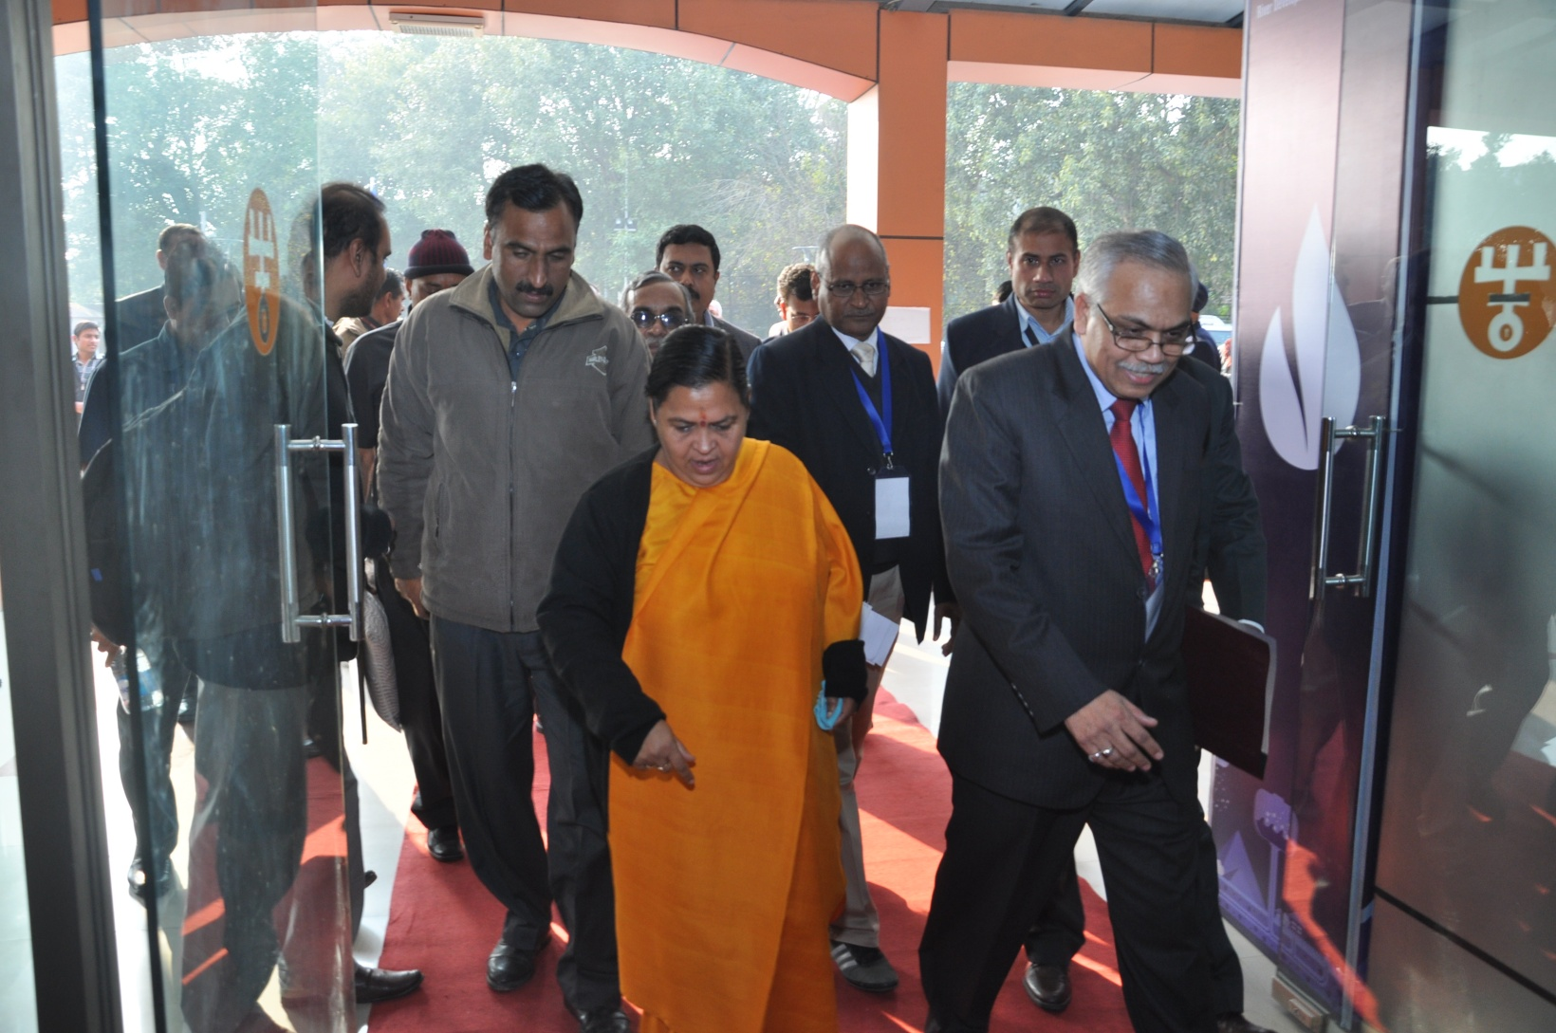

Slide 29
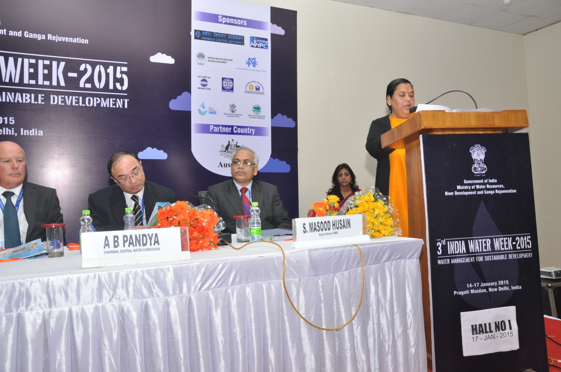

Slide 30
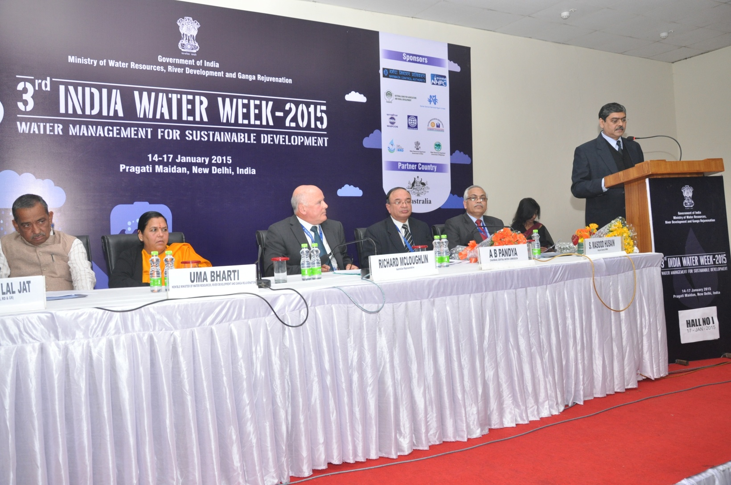

Slide 31
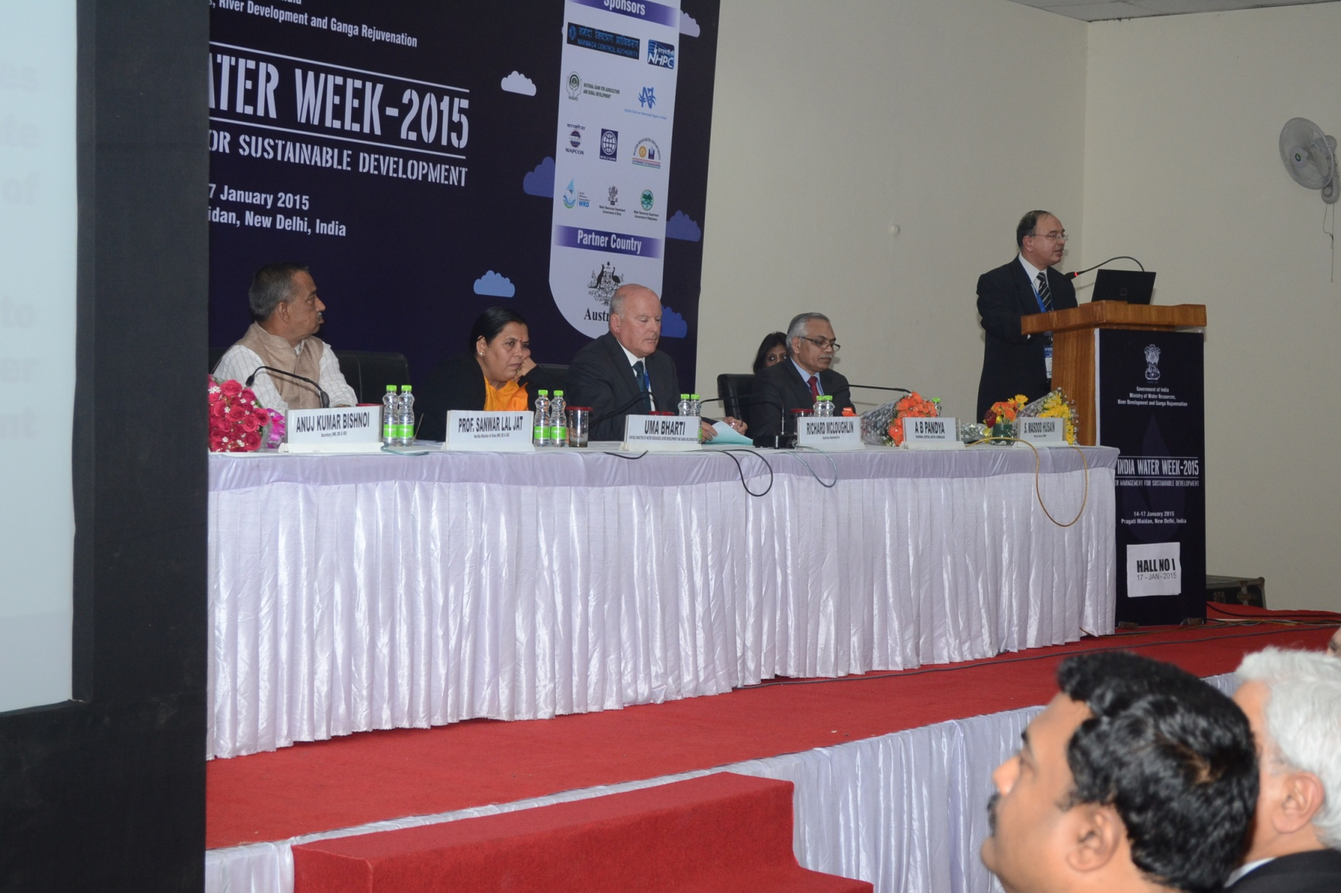

Slide 32
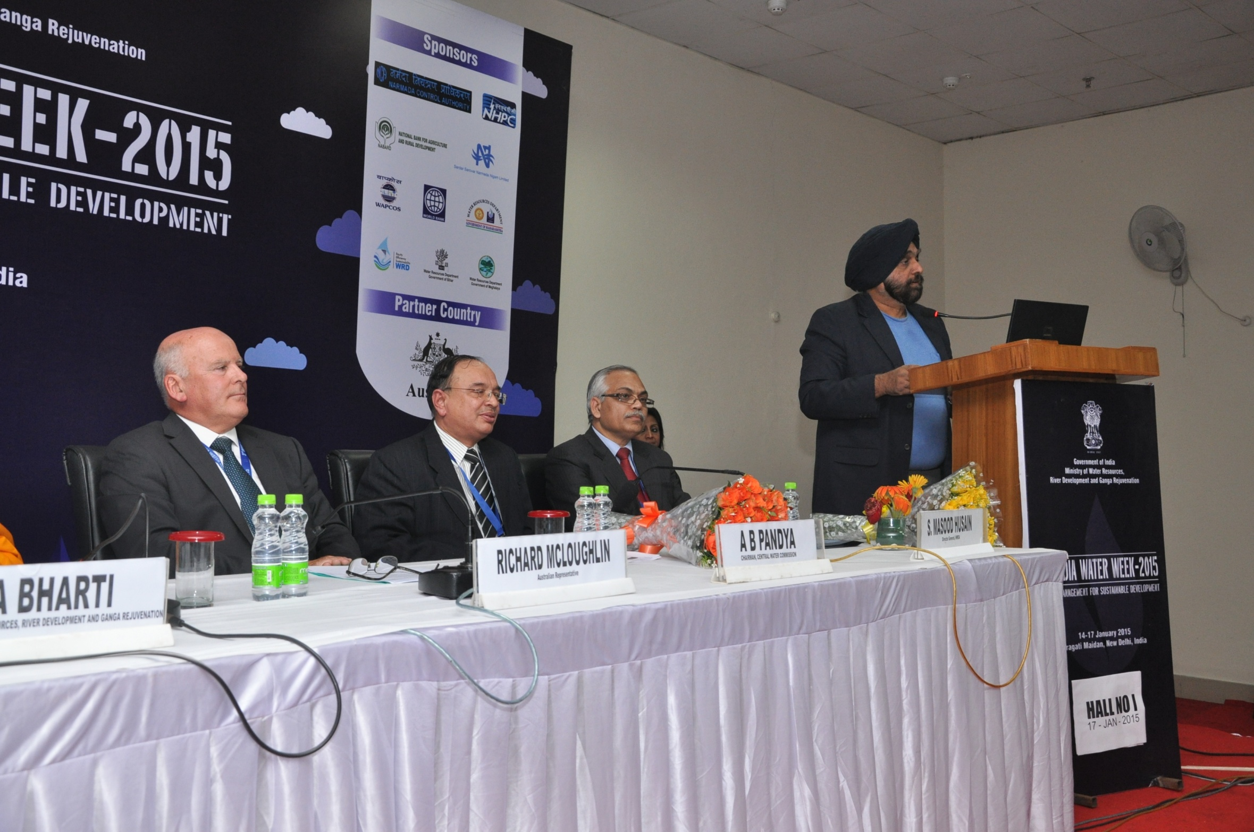

Slide 33
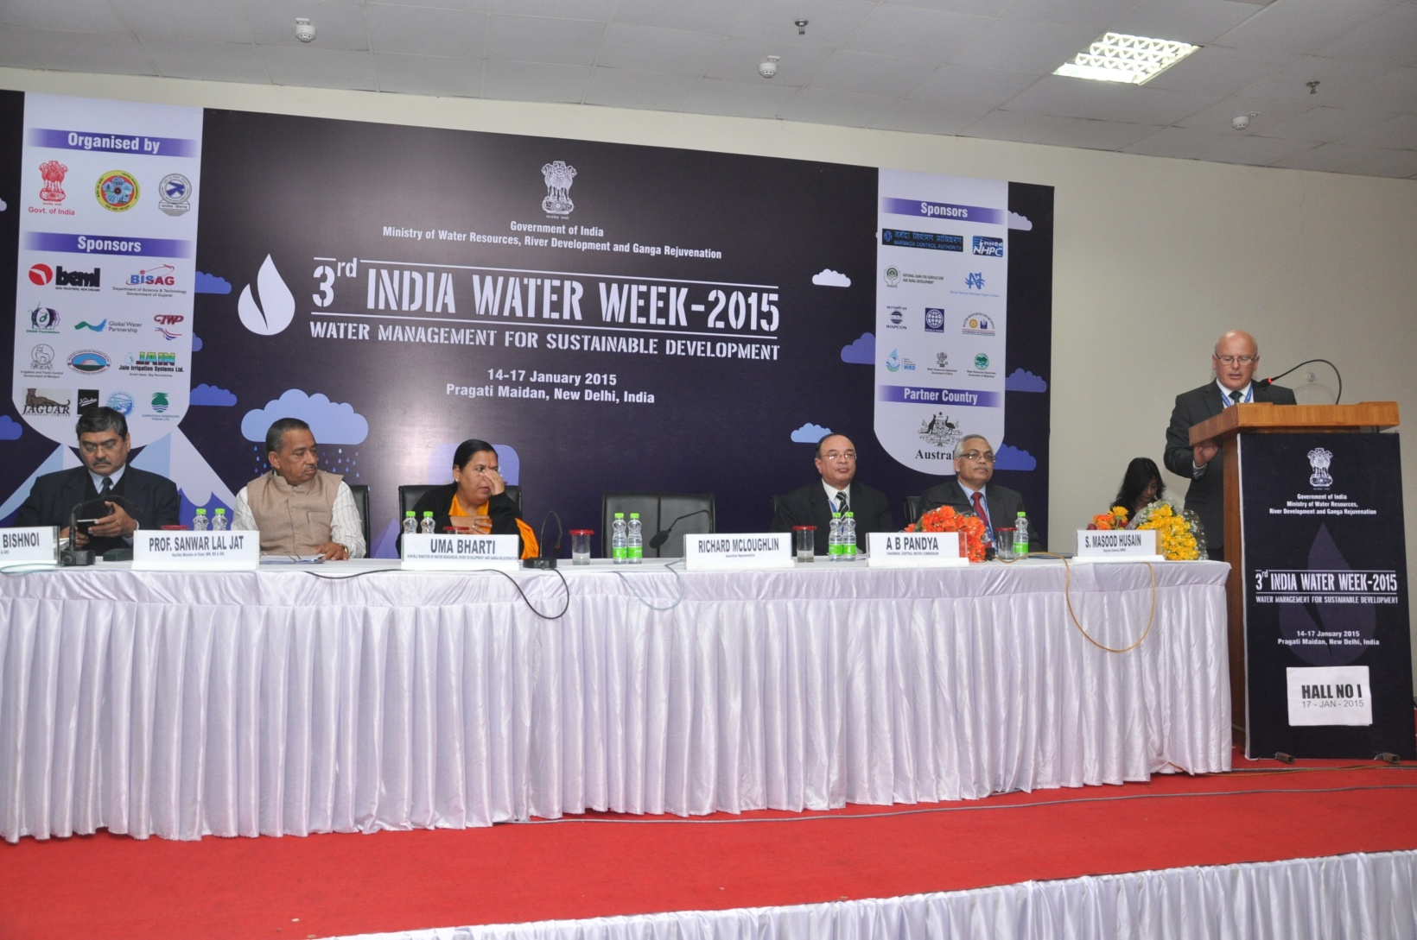

Slide 34
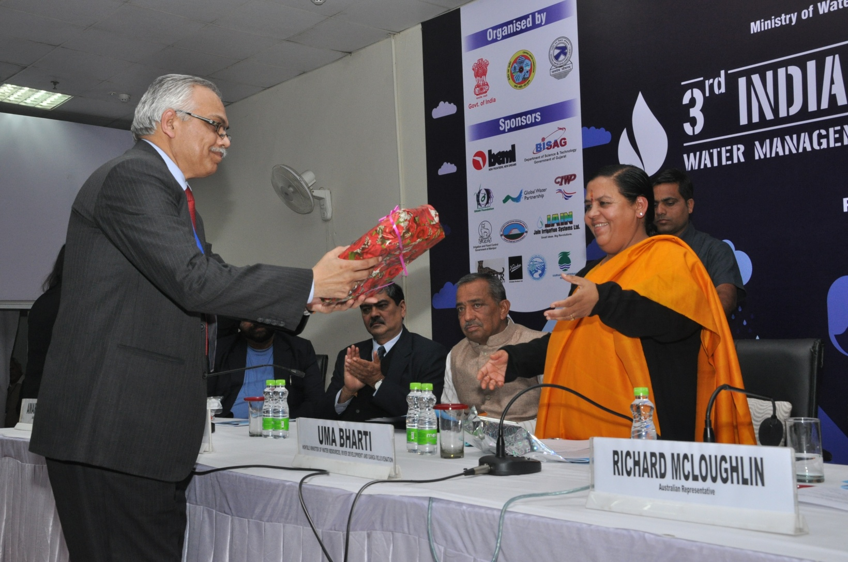

Slide 35
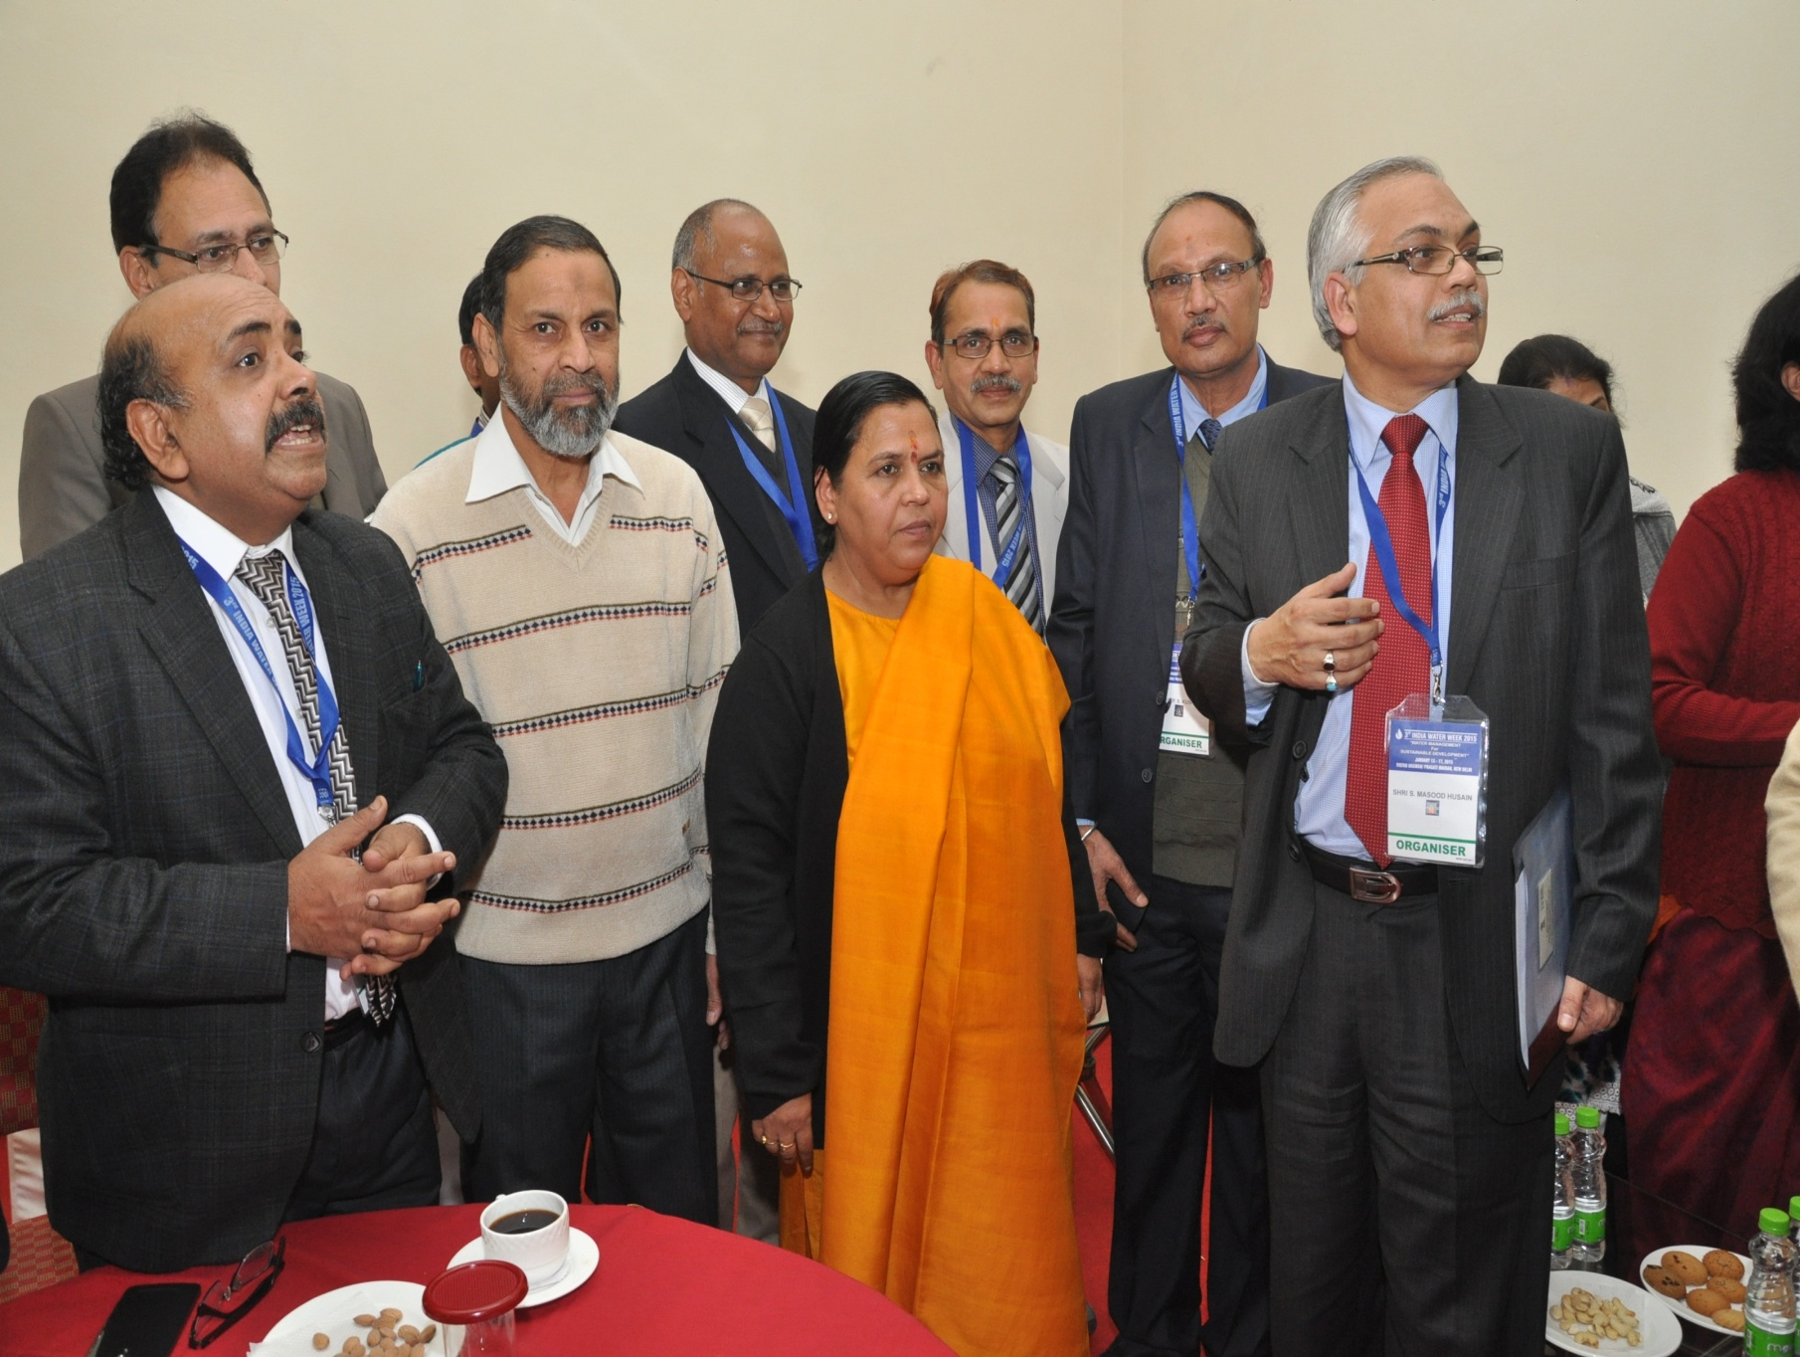

Slide 36
Thanks
India Water Week-2015

