Slide 1

Water Productivity
A Road to Sustainable Agriculture
Dr. Saeed Nairizi
President, ICID
Jan. 2015

Slide 2
Increasing Pressure on Fresh Water Availability for Food Supply

Slide 3
Population Growth
Fresh Water Availability Decline
Climate Change
Industry Development
Environmental Concerns
Change in Water Consumption Pattern

Slide 4
Total Population by regions

Slide 5
The Decline of Water Availability in developing Countries
Source: World Bank 2002a.

Slide 6
Food Supply Dilemma

Slide 7
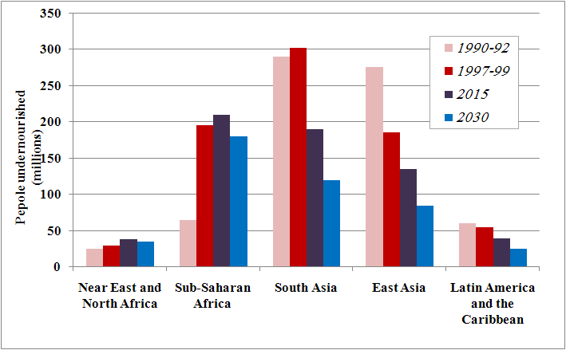
Estimated and projected number of undernourished people by region, 1991-2030

Slide 8
Global Agricultural Production
Rain fed Agriculture
60 %
Irrigated Agriculture
40 %
Notes:
Insert a picture illustrating a season in your country.

Slide 9
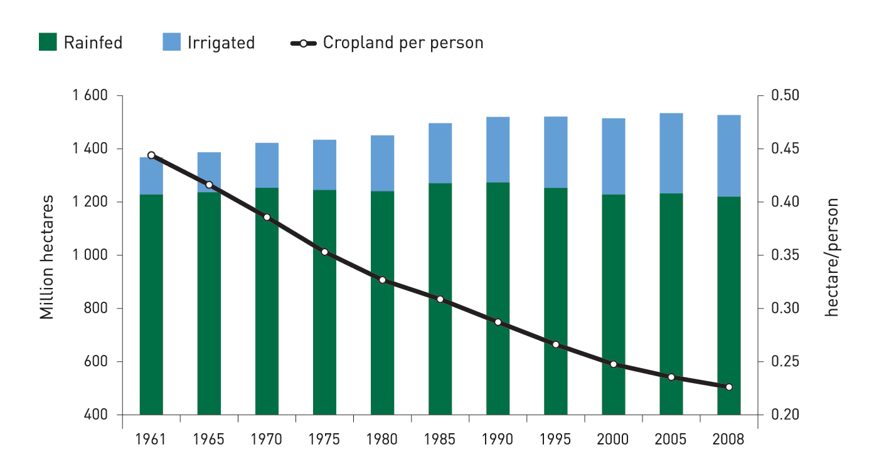
Evolution of cropland surface area (1961-2008)
(data FAO)

Slide 10
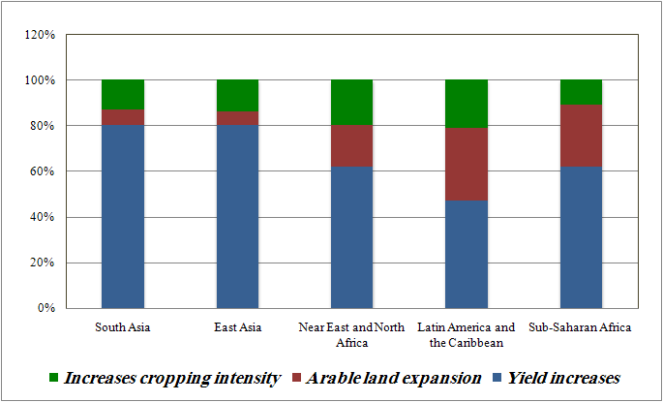
Anticipated Sources of Growth in Crop Production, 1997-2030

Slide 11
Developing Countries Food Self Sufficiency
FAO Reports :
91 % (at present)
86 % (in 2030)
Notes:
Insert a picture of one of the geographic features of your country.

Slide 12
What are the options ?
Rain water productivity
Agricultural water productivity
Notes:
Add key points in the history of your country to the timeline.

Slide 13
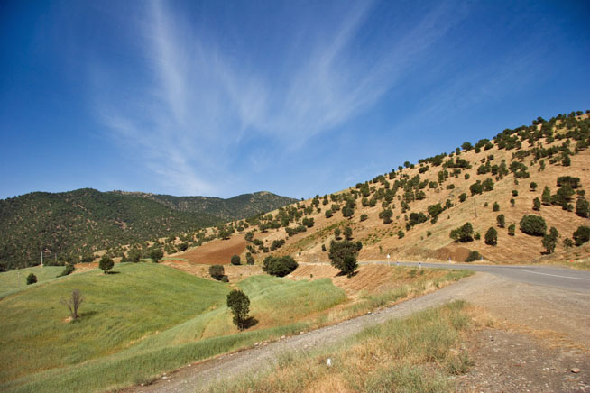
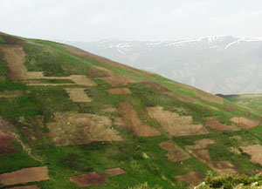
Rain water productivity
Improving and Upgrading the Management of
Dry Farming
Permanent Meadows & Pastures
Forest and Bush Lands

Slide 14
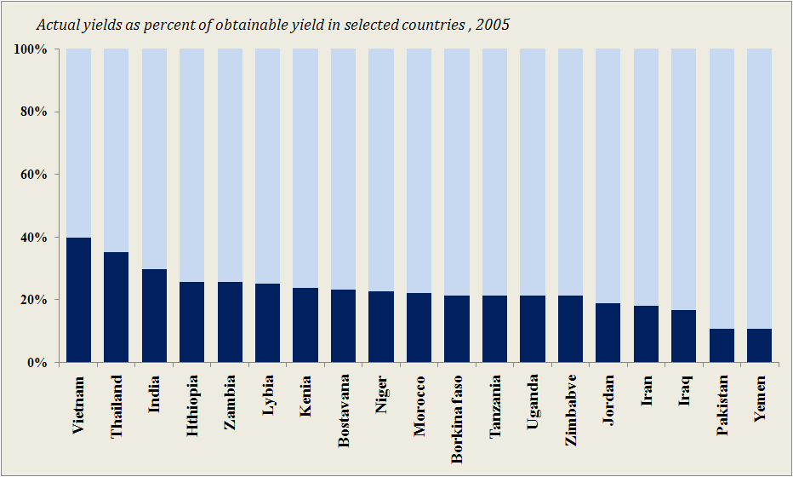
Gaps are large between farmer's actual yield and achievable yields for major rainfed cereal crops

Slide 15
Some Technical Solution for Rain Water Productivity Enhancement
Soil moisture conservation technique
          Minimum to no-till system
          Manure and mulching
          Recycling city waste
Water harvesting
          Small furrows
          Terracing and bunds
          Small dams
Improving varieties and cropping pattern
Supplemental irrigation

Slide 16
Agricultural Water Productivity
Crop yield enhancement
Optimizing crop water requirement
Irrigation water management

Slide 17
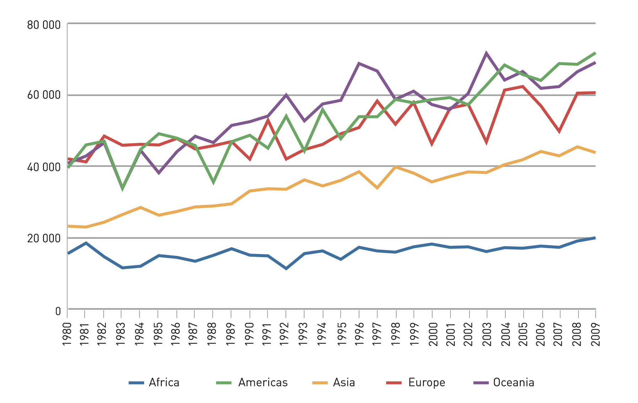
Progress in maize yields in tons/ha by region (1980 – 2009)
data Food and Agriculture Organization of the United Nations (FAO)

Slide 18
Crop yield enhancement
Agro-Technical consideration
Biotechnology practices
Genetic Engineering approaches

Slide 19
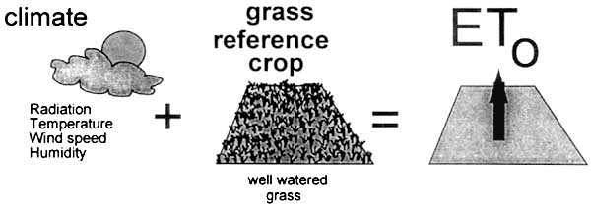
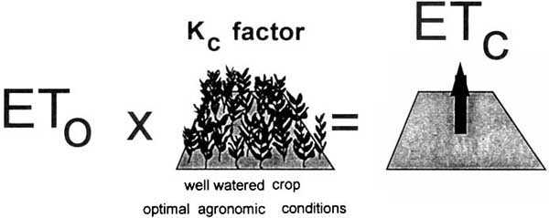
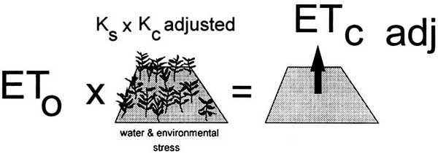
Evapotransporation → Crop Water Requirement

Slide 20
Irrigation Water Management
Irrigation Application Management
Irrigation Water Losses Management
Notes:
Add key points in the history of your country to the timeline.

Slide 21
Irrigation application Management
Economical Considerations
    Deficit irrigation
    Cropping pattern
Technical Improvements
    Irrigation system modernization
    Land leveling
    Canal lining

Slide 22
Irrigation water losses Management
Water use
Non-Consumptive Use
Consumptive Use
Non-recoverable
Recoverable
Beneficial
Non-beneficial

Slide 23
Minimizing the Irrigation Water losses at farm level
Non-beneficial:
  Minimize the Water evaporated or transpired for purposes other than the intended use:
        sub-surface micro irrigation method
        Mulching or covering of soil surface
        Weeding the unwanted vegetation
Non-recoverable
  Reducing flows to:
        saline groundwater sinks
        deep aquifers that are not economically exploitable
        the sea

Slide 24
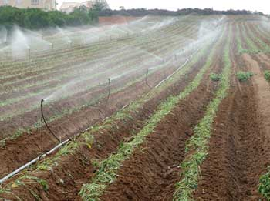
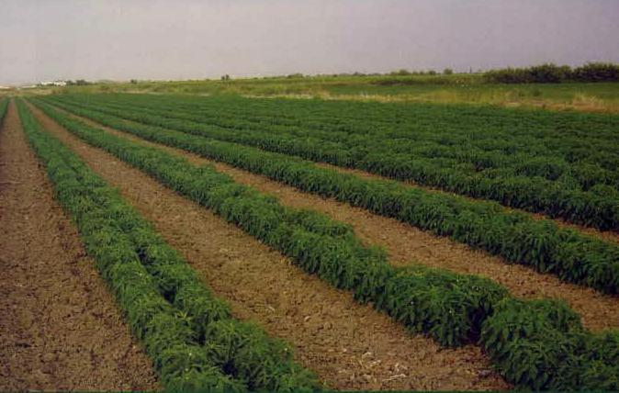
Sprinkler Irrigation
Sub surface micro irrigation
High Evaporation
Low Evaporation

Slide 25
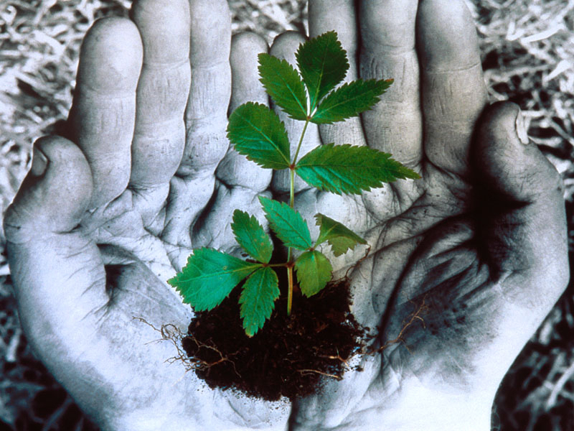
MANY THANKS
FOR
YOUR ATTENTION

