Slide 1
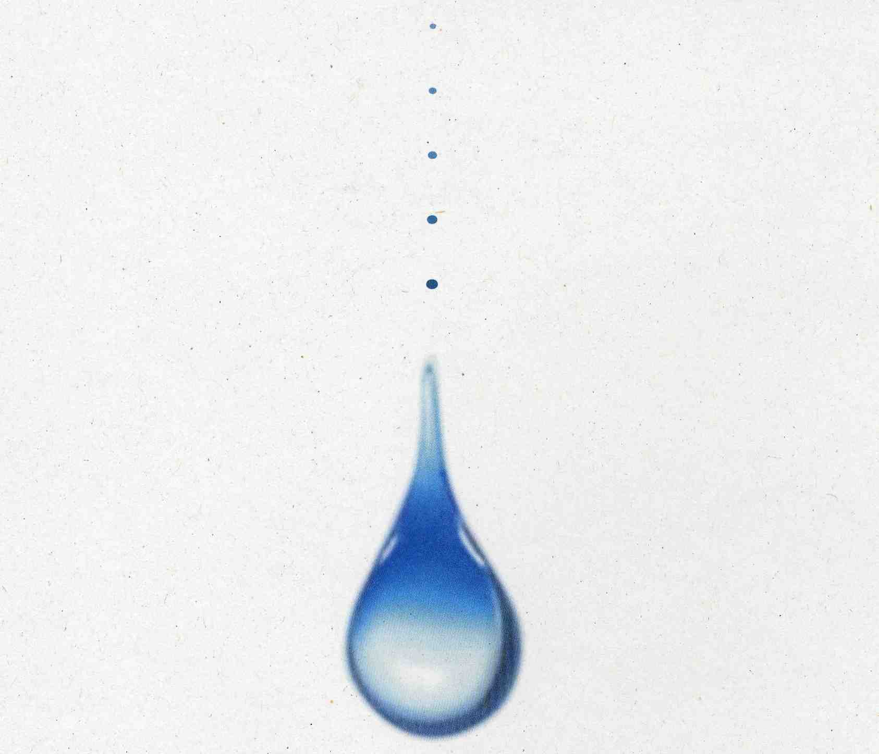
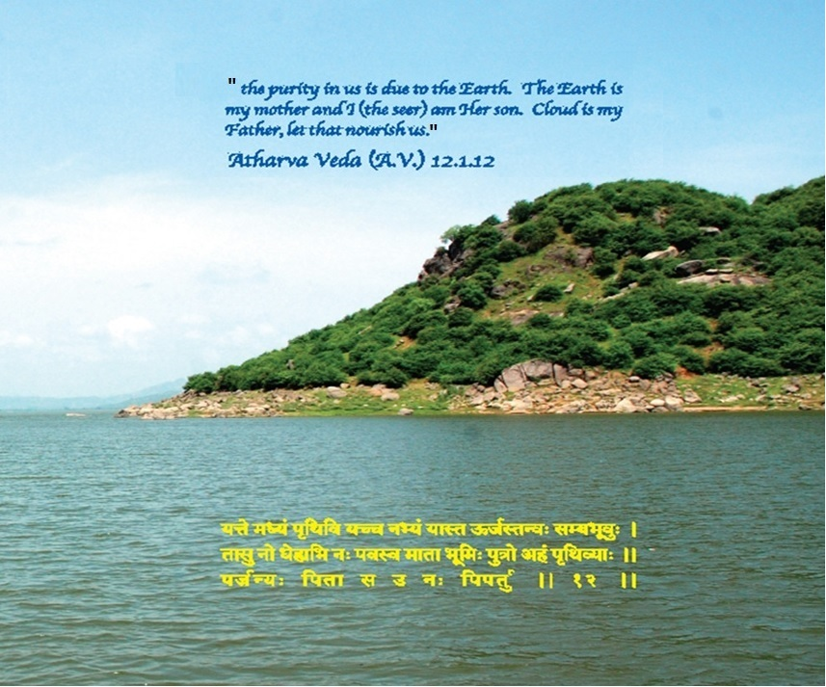
WATER FOR SUSTAINABLE DEVELOPMENT
- A WAY TOWARDS INCLUSIVE GROWTH
B. N. Navalawala,
Chief Advisor to Hon'ble Union Minister (WR, RD & GR) and former Secretary to Govt. of India, Min. of Water Resources.
Delivered on 13-1-2015 as Plenary address at the India Water Week - 2015 (IWW-2015) Conference held on Jan. 13-17, 2015 at Vigyan Bhavan, New Delhi

Slide 2
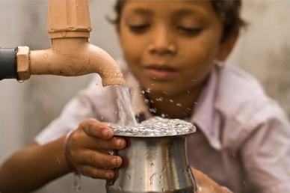
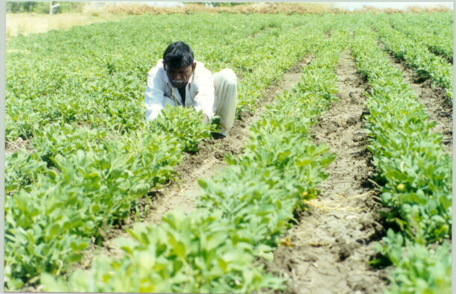
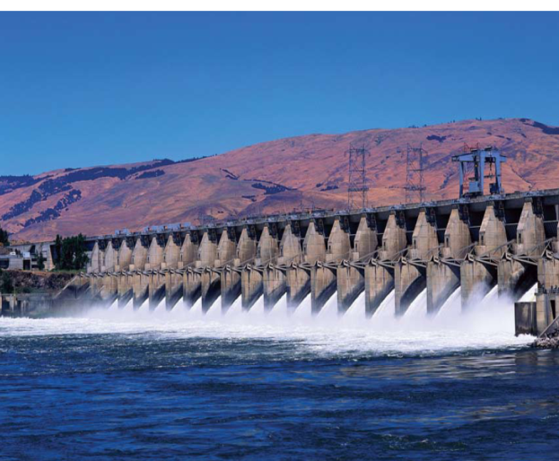
WATER FOR SUSTAINABLE DEVELOPMENT - A WAY TOWARDS INCLUSIVE GROWTH

Slide 3
Human Development – The Role of Water
Each developmental activity needs water – construction, infrastructure, production, agriculture, etc.
Therefore, human endeavors of exploring the potential of life on the Moon or the Mars are all pivoted around the availability of only one substance – water.
Right from the ancient Indian scriptures like Rigveda (6500–3100 B.C.) to Atharvaveda (2000-1500 B.C.) to the latest International Conventions on Water Management, there has been unanimous agreement on the eternal importance of water for sustaining human life and further developing it.

Slide 4
Sustainable Human Development and Inclusive Growth
Sustainable Development means development that can continue for a long without any need of change in its process
Inclusive growth is the development with assured fulfillment of basic needs of the underprivileged masses and unrestrained opportunities for everyone is sustainable development
Inclusive growth essentially requires development without any harm to any section of the society
Decades ago, Mahatma Gandhi – the father of our Nation, gave us a talisman for adjudging any development activity contemplated by asking whether it is going be of any help to the poorest person or weakest person of the society.

Slide 5
Sustainable Human Development and Inclusive Growth
Finally in 1993, United Nations Development Programme (UNDP) named this as ‘human-centered development paradigm’, which led to wide acceptance of the fact that human development, and not economic growth, is the ultimate goal of any society and that economic growth per se does not ensure human development. Inclusive growth is the development with assured fulfillment of basic needs of the underprivileged masses and unrestrained opportunities for everyone is sustainable development

Slide 6
Millennium Development Goals: Milestone or Mirage?
In an admirable attempt to further formalize this paradigm, at the beginning of this 3rd Millennium (September 2000), the world leaders agreed to the Millennium Declaration, wherein a concise set of 8 goals, 18 targets and 48 indicators was fixed in order to assess progress.
The thrust of these Millennium Development Goals to be achieved by 2015 include the Goal of “Extreme poverty and hunger to be halved”.
A close look at the progress made by 2010, when two third of the period is over, indicates that even this modest looking target is going to be the most difficult one to achieve.

Slide 7
Millennium Development Goals : Milestone or Mirage?
It has been recognized that, if properly managed, investment in water resources in dry-land and rain-fed regions may have greater pay offs and at the same time have larger impact on poverty alleviation thus making it a `win-win' strategy.
In the quest for better living standards and economic gain, modern society has come to view water only as a resource that is there for the taking, rather than a living system that drives the workings of a natural world we depend on.
Harmonizing human needs with those of a healthy environment will require new ways of using and managing water. And it will require adjusting our production and consumption patterns so as to remain within ecological limits.

Slide 8
Food Security – Far Beyond Food Production
The foodgrain production in the country has remarkably increased from a modest 50 million tonnes to an awesome 260 million tonnes over a period of six decades.
However, per capita availability of food grain is 436 grams as against about 3,000 grams in USA and 1,000 grams in China.
Food Production is not sufficient though it has attained a praiseworthy rise
Future needs would be more and hence food production would be a serious challenge for India

Slide 9
Dwindling Per Capita Water Availability – a Constraint
Based on average annual water availability, India’s average per capita water availability is 1465 cubic meter per year for its present population of 1275 million, which is expected to reduce to 1318 cubic meter in the year 2025 with the projected population of 1418 million and then further to 1153 cubic meter in the year 2050 with the projected population of 1620 million.
This clearly shows that India will have to be critically dependent on the sustainability of water resources and enhanced productivity of irrigated agriculture in the years to come.

Slide 10
What We Must Do
restrain and manage demand within availability. Doing more with less is the first and easiest step along the path toward water security. With technologies and methods available today, farmers could cut their water needs by 10-50%, industries by 40-90% and cities by a third with no sacrifice of economic output or quality of life.
lay down principles, processes and machinery for the obviation or quick resolution of conflicts
establish a constructive working relationship between civil society institutions such as watershed committees and Panchayati Raj Institutions
formulate a series of area-specific answers for the needs of arid, drought-prone or water-scarce areas, the stress being on local solutions, recourse to external water being exceptional, and avoiding ‘development’ of the water-intensive kind

Slide 11
What We Must Do
revise the National Rehabilitation Policy to make it more just and more humane, and to give the affected people the first claim on the benefits of the project or activity in question
bring about the necessary changes in water laws needed for all this (explicitly recognizing the fundamental right to water, treating water as a common pool resource to be managed by the community or held as a public trust by the state, de-linking control of groundwater from ownership of land, etc); laws that view water as one, undivided, unified entity instead of ground water, surface water, etc. and providing for different and fragmented control mechanisms
bring about a major transformation in the way people think about water

Slide 12
Conclusion
The water crisis is part of a larger crisis of ‘development’; and one must have wisdom do understand the causation, consequences and solutions of the same.
Existence of society is the basis of development and therefore wisdom must be allowed to penetrate every section of the society to ensure its sustainability.
Development due to engineering and technology can be sustained only by sensible water resource management. It is a time tested principle that the ancient most civilizations of the world have to teach to the modern population that depends more on technology than rudimentary and universal principles of pure science and social science.
No longer, we have any soft options - only hard choices.

Slide 13

THANKS

