Slide 1



Water SECURITY FOR sustainability
Doğan Altınbilek
Vice-President
World Water Council
TOGETHER WE MAKE WATER A GLOBAL PRIORITY
Notes:
Ladies and Gentlemen,
Dear Friends,
Let me start by expressing my appreciation for this invitation on behalf of the World Water Council. This first slide gives you the essence of the Council: we are institutions working together – with our various expertise and experience – to make water security a global priority. Indeed, we believe that water is the key for global sustainability.

Slide 2
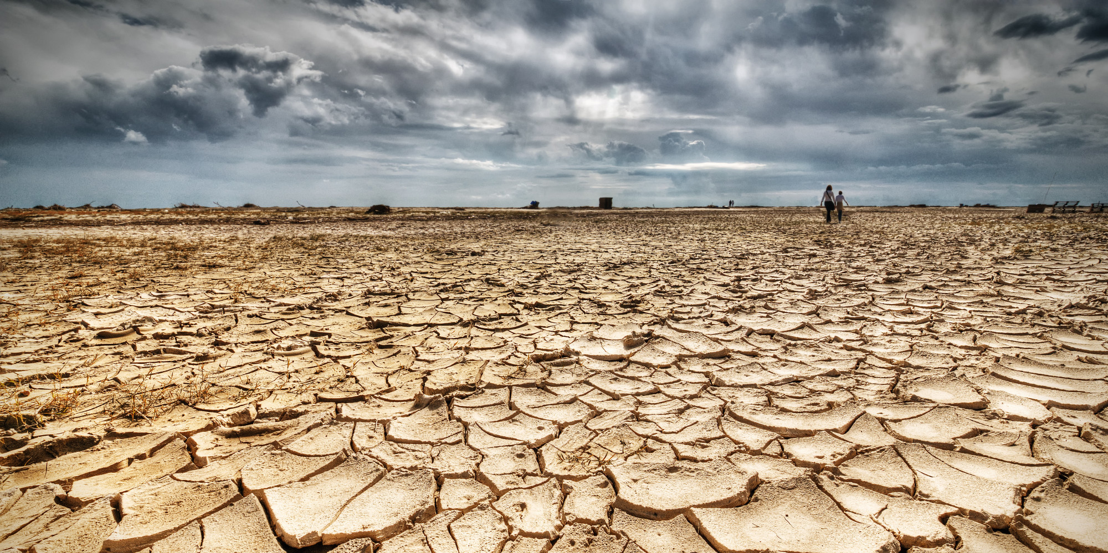
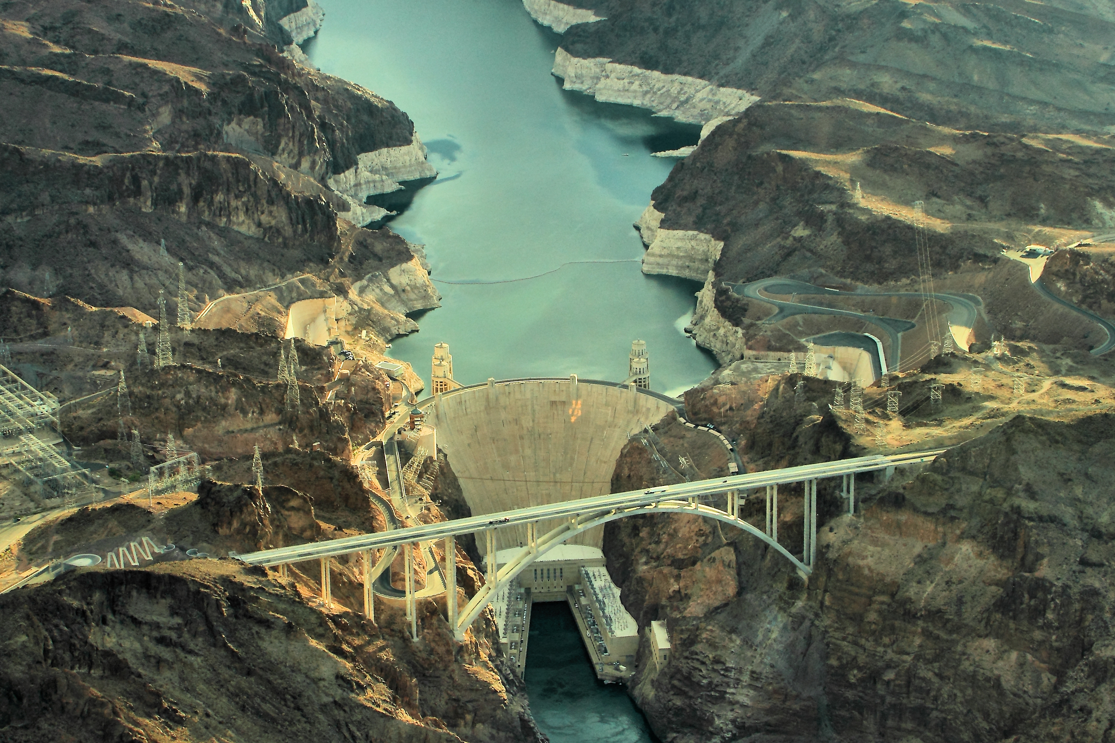
TOGETHER WE MAKE WATER A GLOBAL PRIORITY
A LOOMING WATER CRISIS
2.8 billion people live in areas of high water stress
2.5 billion people don't have access to adequate sanitation
1.3 billion people continue to live without access to electricity world wide
805 million people are chronically undernourished
780 million people do not have access to safe drinking water
Notes:
First of all, a few words on what the world looks like today:
Many of you in this room are well aware of water related issues. Some talk about crises, some talk about progress. Today it is a fact 780 million people still do not have access to safe drinking water and 2.5 billion people do not have access to basic sanitation. Unclean water kills more children than war every year.
This situation also applies for food as about 805 million people are chronically undernourished and 1.3 billion people continue to live without access to electricity world wide.
To prepare a sustainable future and meet global needs, water is the greatest game changer.

Slide 3
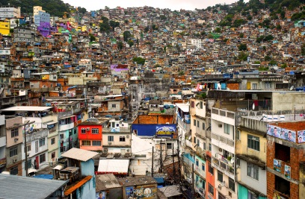
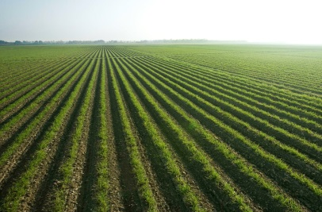
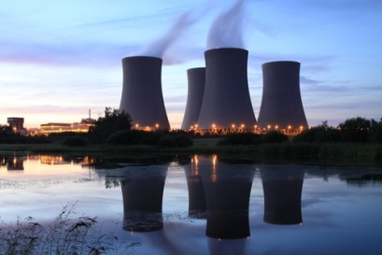
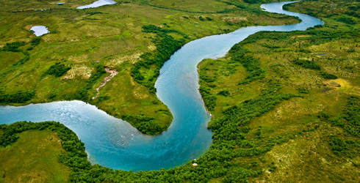
TOGETHER WE MAKE WATER A GLOBAL PRIORITY
OUR WORLD RIGHT NOW
Water connects all aspects of growth and development
Health and human settlements
Food and agriculture
Energy and industry
Environment
DEMAND INCREASE
Changing settlement patterns, with a 2004-15 to see 40% increase in urban population without basic WSS access
70% increase in food production will be required in 40 years
Global energy consumption expected to increase by ~40% from 2007-2030
Over-consumption of water and water pollution results in loss of massive ecosystem benefits
IMPACTS ON GROWTH
Lack of sanitation access can cost countries up to 6% of GDP
Unreliable water supply can deprive farmers of 2/3 of their potential income
Energy security is threatened by water challenges
Losses of ecosystem services with increasingly visible economic cost
Notes:
Water is more than flow or cycle, it is the common thread connecting all aspects of development.
As urban population keeps growing , with new consuming patterns requiring more water to produce food and and provide sufficient energy, these new lifestyles are hampering the services rendered by our environment and eventually increasing the cost of development.
According to the 2030 Water Resources Group, one-third of the world’s population will live near water basins where the water deficit will be larger than 50 % by 2030.
By 2030, world population will account 8.3 billion. If no efficiency gains are assumed in regards to the economic path followed, global water requirements will grow from 4.5 thousand km³ to 6.9 thousand km³. This amount increase is 40% above current accessible and reliable supplies.
To respond to this situation, the World Water Council has funded its strategy on the principle of water security to sustain our future.

Slide 4
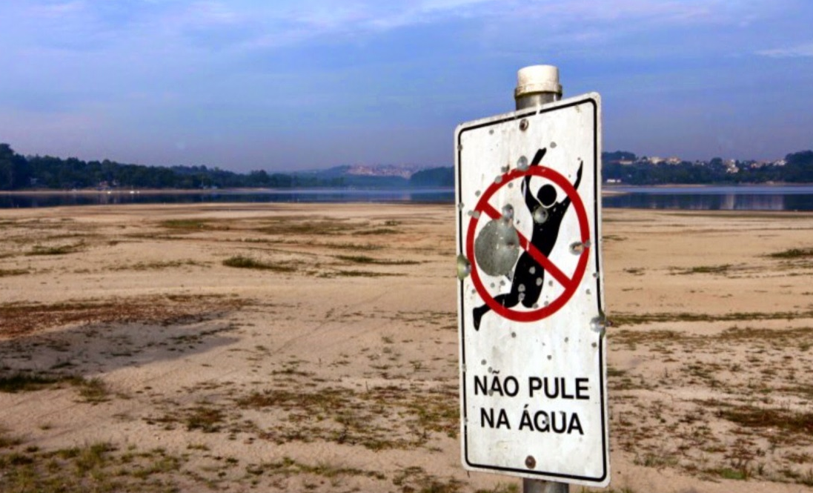
TOGETHER WE MAKE WATER A GLOBAL PRIORITY
THE ROLE OF WATER SECURITY
SECURING WATER TO ENSURE A BETTER FUTURE FOR THE GENERATIONS TO COME
Notes:
Our English Dictionaries define security as: “ freedom from danger, from fear or anxiety, from want or deprivation.”
As you will all agree, humans have always been searching for security in their relations with water, by trying to be sure we have good water, in the right quantity at the proper time and place, by predicting floods, reserving sources for droughts and using water to help us generate wealth and avoid deprivation.
Today, water security requires to link food, energy, climate, economic growth and human security challenges that the world is facing.
In this perspective, achieving a water secure world requires to have :
Water policies and plans incorporated into national and international development processes.
World leaders and funding agencies to appreciate, in the long run, investment in water, as an opportunity rather than a problem.
Partnerships for action and innovation at all levels among communities, nations, river basins, and globally.
Go beyond what is normally considered as “water business” to entail major changes in the way water impacts sectors such as water supply and sanitation, agriculture, energy, industry and human settlements.
Trade-offs made between social, environmental and economic priorities, as well as soft” institutional and “hard” solutions such as investments, at small or large scale, to store and transport water.
And share a common definition as national priorities vary from one country to another and impact the minimal amounts of water needed thus the amount of water to be secured.

Slide 5
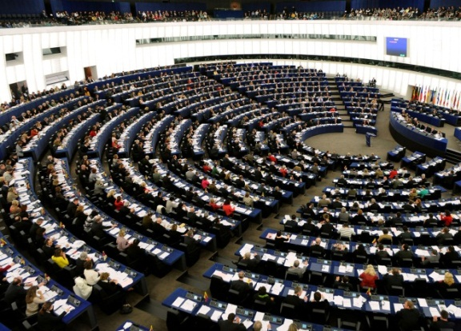
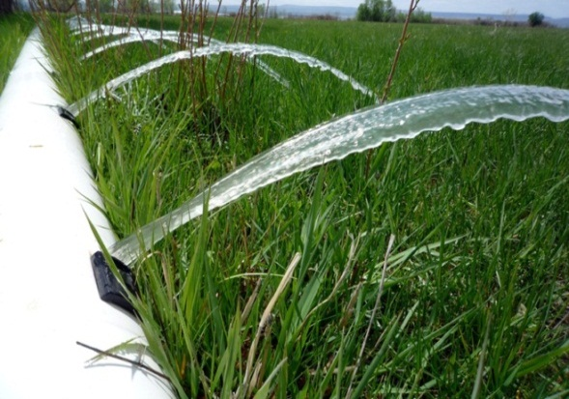
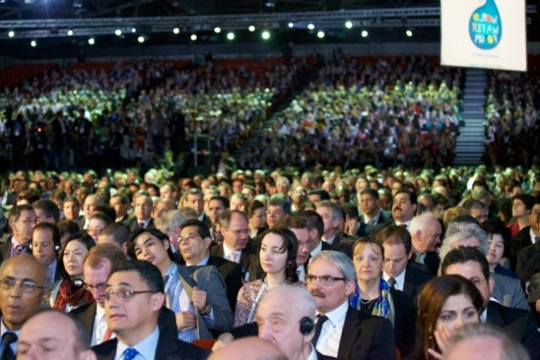
TOGETHER WE MAKE WATER A GLOBAL PRIORITY
THE PACT FOR WATER SECURITY
FOCUS FOR 2013-2015
Bringing
people together through active
hydro-politics
Exploring
ideas
and
concepts
Catalyzing collective action during and
in between each
World Water Forum
Notes:
To respond to this objective, the World Water Council has established a strategy, the PACT FOR WATER SECURITY, that guides our action mainly focused on 3 guiding principles:
Bringing people together through active hydro-politics:
We work at the highest political level from the UN to National and Local Governments and Parliamentarians.
We participate in major discussions, high-level conferences and events in the political agenda with the United Nations, the World Bank, the OECD, etc.
2. Exploring new ideas and concepts:
Together with our members we study, explore, understand and catalyze emerging themes around water.
3. We also focus on catalyzing collective action during and in between each World Water Forum:
Next April, we will be organizing the 7th World Water Forum in Daegu-Gyeongbuk, Korea together with the Government of Korea and the host city, Daegu-Gyeongbuk.
We are also following up on the outcomes of the 6th World Water Forum that took place in Marseille, France in 2012.
The selected country to host the 8th Forum in 2018 will be Brazil.

Slide 6
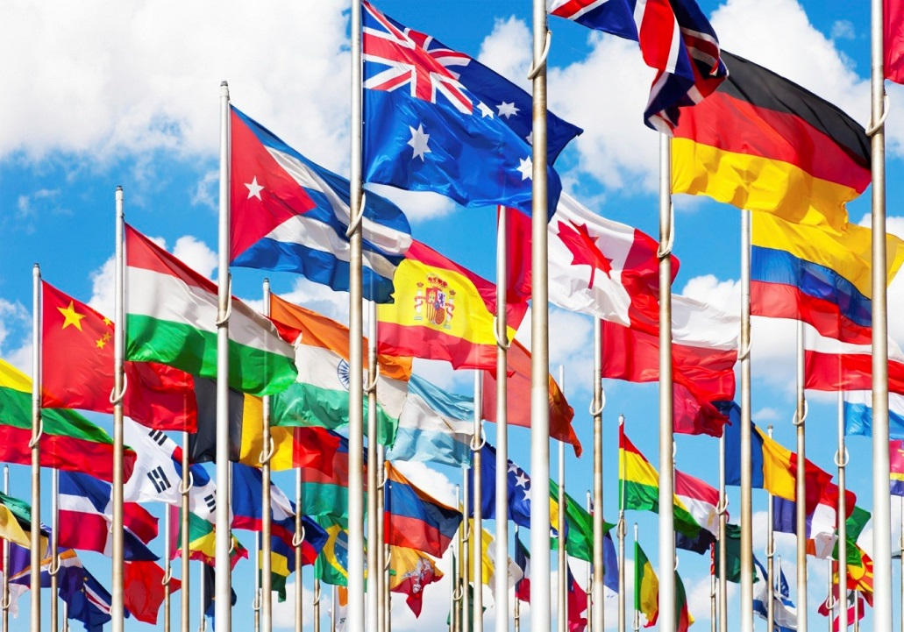
TOGETHER WE MAKE WATER A GLOBAL PRIORITY
A STRATEGIC APPROACH
Active
hydro-politics
The United Nations system
International Organizations
National Governments
Parliamentarians
Local Authorities
Notes:
In terms of hydro-politics, we work towards increasing awareness of high-level decision makers on water issues.
We work with:
The United Nations system to set water as a Post-2015 Sustainable Development Goal.
UN SG's Advisory Board on Water and Sanitation on the issues of water related disasters.
UN Habitat on issues related to Local and Regional Authorities.
The OECD on the Water Governance Initiative in support of better governance in the water sector.
National Governments to guide, advise, evaluate and monitor water related issues.
Parliaments to help them emphasize and consolidate their role in the future of water by the development of an online Helpdesk on water legislation.
Local Authorities with the Istanbul Water Consensus to improve practices in water management at local scale.

Slide 7
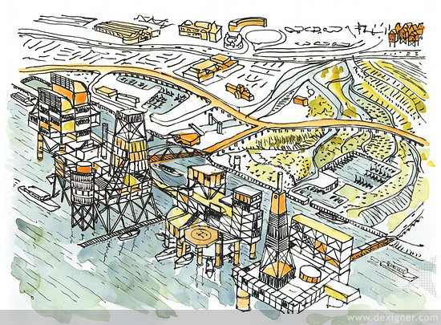
TOGETHER WE MAKE WATER A GLOBAL PRIORITY
A STRATEGIC APPROACH
Ideas and concepts
Water and Green Growth
Water Infrastructure Financing
Water and Food
Water and Energy
Climate change
Water-related disasters
IWRM
Notes:
By exploring specific ideas and concepts, the Council establishes dedicated partnerships and working groups on all emerging issues connected to water:
On Water and Green Growth, we work with the Korean government to demonstrate the role of water for green growth and propose a framework for its implementation.
On Water Infrastructure Financing, the Council has recently started a partnership under the Chairmanship of the OECD , to create a High-Level Panel on Infrastructure Financing for a Water Secure World. This Panel aims to set out clear objectives and to look into the necessary financial resources and the means to achieve water security in different parts of the world.
On Water and Climate Change by building resilience to variable climates through hard and soft solutions. We have recently started a partnership with the Government of Mexico, Turkey and China, on the role of storage and reservoirs in a climate change context.
On Water and Food, we are currently establishing with the FAO a High Level Panel on Water for Food Security.
On Water and Energy, the Council is working with Electricité de France to further analyze the water and energy nexus and the multi-purpose water uses of hydropower reservoirs.
On Water-related disasters, the World Water Council is an active member of the High-Level Expert Panel on Water and Disaster of UNSGAB.
On IWRM, the Council has set a dedicated task force to mainstream IWRM-thinking in the post-2015 development agenda.

Slide 8
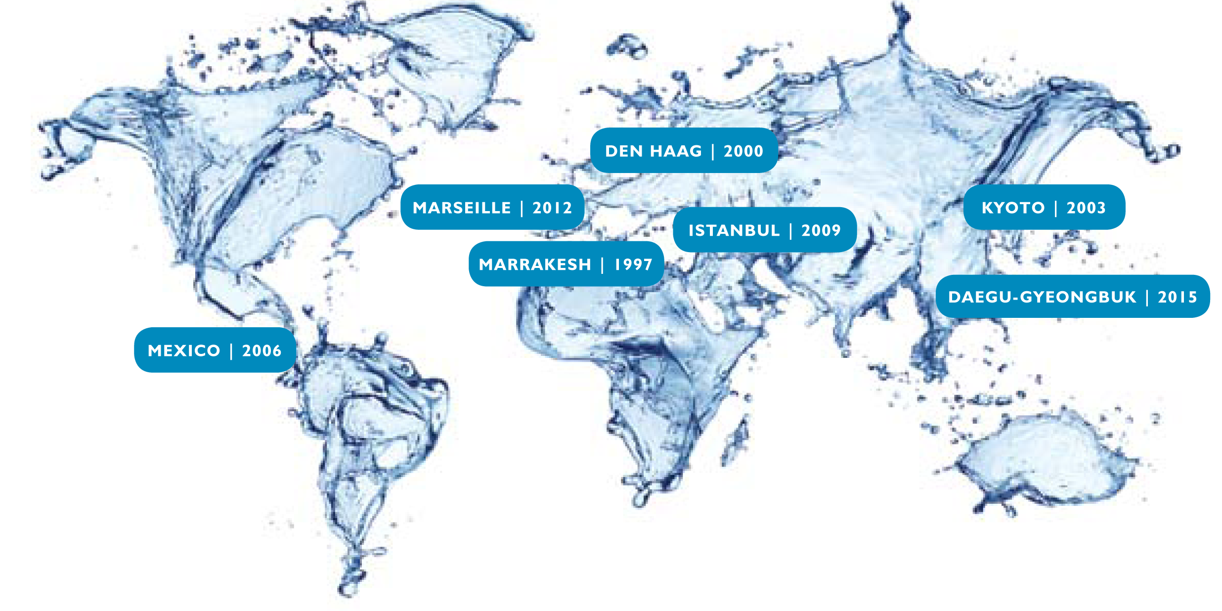
TOGETHER WE MAKE WATER A GLOBAL PRIORITY
The World Water Forum
Notes:
The third guiding principle of the Council is to co-organize with a host country the World Water Forum. The next edition will be held in Korea, in Daegu-Gyeongbuk on 12-17 April 2015. The Forum offers a unique opportunity to convey our message and all the commited stakeholders of the global water community.
Indeed, the World Water Forum is the largest international event in the field of water.
20,000 participants from 173 countries attended the last edition in 2012. Heads of State, Ministers, Mayors, Parliamentarians attended alongside the water community and the public at large.
The first World Water Forum took place in Marrakesh, Morrocco in 1997 followed by the The Hague, the Netherlands in 2000; Kyoto, Japan in 2003; Mexico City, Mexico in 2006; Istanbul, Turkey in 2009 and Marseille, France in 2012. The next one will be held in Daegu-Gyeongbuk, Republic of Korea in 2015, followed by Brasilia, Brazil in 2018.
The Forum is THE international meeting place for water.
It raises awareness of politicians, leaders and the public on water issues and solutions.
It also reinforces dialogue between all stakeholders through political, thematic and regional processes that are prepared over a two-year period.
On the occasion of the 7th World Water Forum, we will bring decision-makers together from the highest political level at the UN to National and Local Governments and Parliamentarians by asking for commitments and to implement identified needs.

Slide 9

TOGETHER WE MAKE WATER A GLOBAL PRIORITY
THE WORLD WATER COUNCIL
A worldwide network with wide-ranging competencies that facilitates water policy dialogue and motivates actions
Notes:
Through these joint-efforts, the World Water Council has established a worldwide network with wide-ranging competencies that facilitates water policy dialogue and motivates actions, in order to promote water security concepts and solutions to all concerned parties, from decisions makers to beneficiaries.
For us to connect to these high-level decision-makers and influence the global agenda, we keep track of regional realities and promote innovative solutions. We will only contribute to solving water issues by multiplying and scaling up the many concrete solutions that have been developed in countries to better manage and protect resources which is possible through the sharing of knowledge and experiences allowed by the Forum.

Slide 10
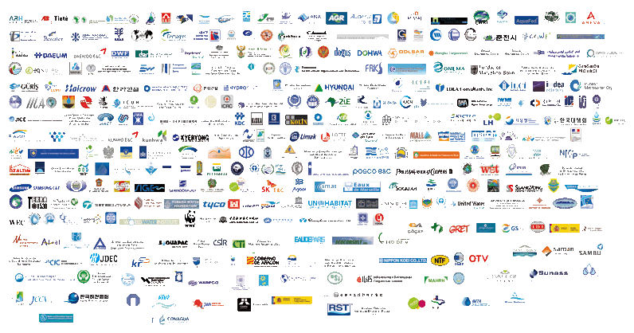


TOGETHER WE MAKE WATER A GLOBAL PRIORITY
COUNCIL MEMBERS
Governments,
Ministries
and Agencies
International
Organizations
Local and Regional
Authorities
Private/Public/
Academic Groups
and Businesses
Intergovernmental
Organizations
UN Agencies
300 organizations from more than 50 countries
Notes:
Today, we truly form an international organization as we represent more than 300 organizations from over 50 countries.
This network of members represents organizations with strong expertise in research, project engineering, politics, policy formulation, business development, NGO mobilization, public management, private development and intergovernmental collaborations.
All of them have the possibility to influence politics and to frame to frame the agenda for the World Water Forum.
To enlarge their networks to convey their message all over the world.
We work together – thanks to and despite – their differences to facilitate to catalyze collective action – especially.
The Water Water Council believes that all of our membres are game changers to implement sustainable pratices through and by water security for sustainibilty.
Let me underline a few things about the World Water Council members:
They truly form a unique network of thousands of people from different sectors, regions, disciplines and professional fields.
They have enormous expertise and experience and through their collaborative efforts they strongly commit to advancing the water agenda among all stakeholders.
Their credibility and involvement help solve the complex water-related challenges all over the world.

Slide 11
THANK YOU
worldwatercouncil.org

